Slide 1
Information on Local Care Partnerships
August 2023

Slide 2
One Devon Architecture: (Under Review)
Devon County Council
Devon County Council
Devon County Council
One Devon Partnership
NHS Devon
Health and Wellbeing Board
ICS Executive Committee
VCSE Assembly*
Clinical and Professional Cabinet*
Health and Wellbeing Board
Health and Wellbeing Board
Plymouth City Council
Health and Wellbeing Board
Local Care Partnerships x5
Neighbourhoods
Acute Provider Collaborative**
MHLDN Provider Collaborative
Primary & Community Care Provider Collaborative
Torbay Council
NHS Cornwall and the Isles of Scilly
Health and Wellbeing Board
Primary Care Networks
*Consultative forums will also play an advisory role for Local Care Partnerships and Provider Collaboratives as determined by these groups
**The Acute Provider Collaborative spans Devon and Cornwall and the Isles of Scilly

Slide 3
Local Care Partnerships are created in order to serve the health and care needs of people living in their are
The purpose of the Local Care Partnerships in the ICS implementation framework
Our vision for a thriving Local Care Partnerships in Devon:
Involve all partners who contribute to health and care in their LCP, including housing, schools, Healthwatch and other Community Groups, employment & training and emergency services, in the co-ordination, planning and delivery of integrated services within localities and alongside communities
Go beyond strategic planning, including joint commissioning, and integrated service delivery
Work to reduce inequalities in their LCP
Local Care Partnerships are collaborative arrangements formed by organisations responsible for arranging and delivering health and care services in the 5 localities within Devon. They lead the detailed design and delivery of integrated services in their area, built on a mutual understanding of their local population, trust and a shared vision for the place. Respected as experts on the health and care needs of their population, LCP partners feel supported by the partnership and also feel that the LCP represents their views, opinions, and priorities at larger forums such as the One Devon Partnership, whilst also working to develop the economy in their area. The LCP is constantly engaging with people living and working in its area and people feel able to have an honest conversation about their health and care needs.
Source: Source:2021 Implementation Guidance
Primary responsibilities in 2022/23:
Additional responsibilities beyond 2022/23:
The primary responsibilities of the Local Care Partnerships are:
Supporting the development of the Integrated Care Strategy via One Devon Partnership representation
Develop and implement demonstrator projects, supported by the One Devon Partnership and NHS Devon to take a learn by doing approach, and embedding innovation throughout LCPs
Solidify relationships with wider local organisations
Enhancing service integration in their LCP
Improving performance of local services where joint working can improve overall performance
Planning changes to the provision of services in place to deliver improved integrated care and improved performance
Delivering relevant strategic priorities for Devon that apply to the local population
Procuring and securing health and care services to meet the needs of local communities, commissioning at the level of place

Slide 4
Devon’s Local Care Partnerships will make commissioning decisions informed by a detailed understanding of the needs of local people
Local Care Partnerships
In the future, the decisions that Local Care Partnerships make will involve:
Agreeing Local Care Partnership priorities as derived via partnership working with the relevant Health and Wellbeing Boards
Agreeing the local response to the Integrated Care Strategy, coordinating delivery
Coordinating services to meet the health needs of local populations
Planning changes to the provision of services in place to deliver improved integrated care and improved performance –with a particular focus on improvement of preventative and proactive services
Informing the Provider Collaborative around the needs of the population and ensuring the Provider Collaborative can balance working at scale with a local focus
Deciding on how to commission services for the local community, where commissioning responsibility has been delegated by NHS Devon or a Local Authority
Identifying how to optimise use of workforce to manage capacity, including with other partners such as the VCSE
Identifying how to best make use of existing community groups and forums, transforming community engagement
What decisions does this group make?
There are five Local Care Partnerships in Devon: North Devon LCP, East Devon LCP, South Devon LCP, West Devon LCP, and Plymouth LCP. The LCPs influence the direction of One Devon via representation on the One Devon Partnership Core Committee. The close collaboration between health and care is core to LCPs, including Local Authorities, NHS providers, VCSE sector and other partners.
VCSE Assembly
Local Authorities
NHS Devon
One Devon Partnership
Key
How does this group support other partners:
Financial Flows
Advisory relationships
Provider Collaboratives
Local Care Partnerships
Health and social care providers
Other local businesses and services

Slide 5
The Local Care Partnerships have agreed to work via a consistent governance approach in delivering health and care for their populations
Responsibilities:
Local Care Partnerships Structure:
To enable the decisions to take place as articulated on slides 36-37, the following responsibilities could be delegated to Local Care Partnerships by:
NHS Devon:
Delegated commissioning responsibility for the provision of community health and care in LCPs
NHS Providers:
Delegated authority to make changes to the provision of health and care in LCPs
Local Authorities:
Delegated commissioning responsibility for the provision of some agreed services in LCPs
The Local Care Partnerships have agreed to work via a consistent governance approach to commission and co-ordinate health and care services for their population, and will each have:
An LCP Executive Group – responsible for the development of LCP strategy and the representation of the LCP at partnership forums. Where the delivery group cannot reach consensus, decisions may be escalated to the executive group
An LCP Delivery Group – operated by consensus, defining the LCP delivery plan and allocating resource against the workplan
LCP Specific Arrangements – variable between Local Care Partnerships
The staffing of LCPs will include NHS Devon locality teams and agreed commissioning support functions, in addition to staff from partner organisations. They will avoid working in silos, working together with other LCPs and with Provider Collaboratives to share knowledge and resources and avoiding duplication.
Organisational Governance:
Initially, LCPs will be formed as consultative forums, advising the LCP Oversight Committee of NHS Devon. Whilst constituted as consultative forums, the LCP Oversight Committee will be accountable to NHS Devon for the delivery of LCP responsibilities.
As they develop, Local Care Partnerships will become committees of NHS Devon, able to access and hold budgetary responsibilities in their own right.
Local Care Partnerships will be better placed to align budgets between Local Authorities and NHS. In addition they will be able to access pooled Local Authority funding via Section 75 and 76 agreements made between Local Authorities and NHS Devon as appropriate, in addition of Section 256 agreements and the Better Care Fund.

Slide 6
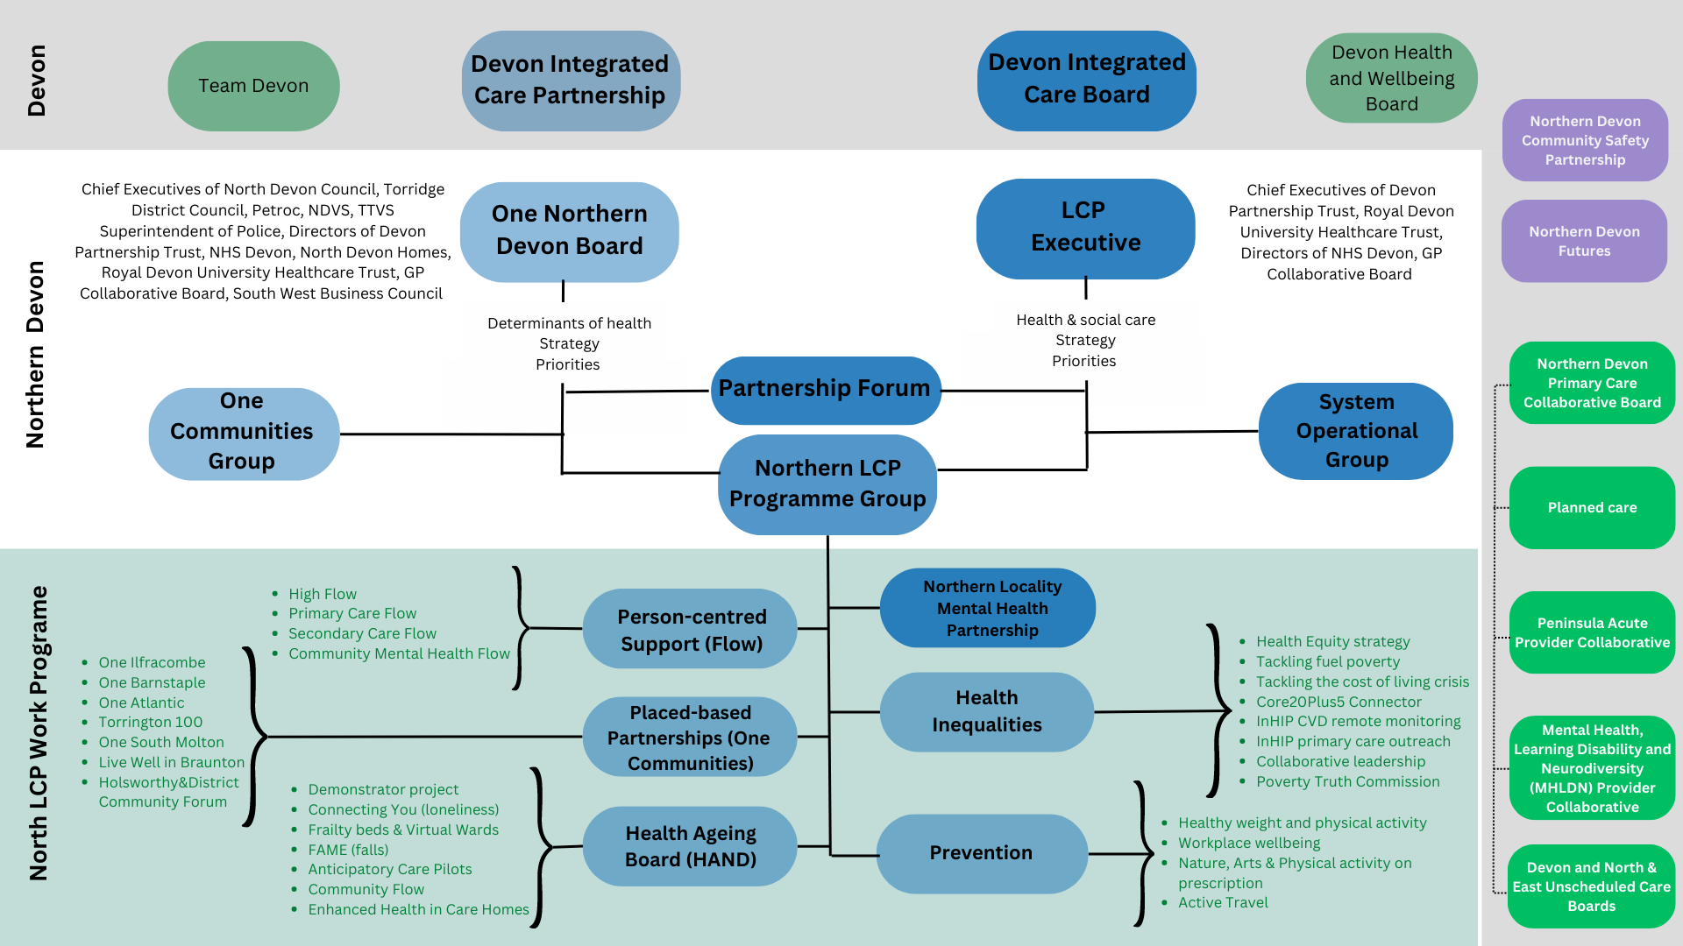
Northern Local Care Partnership Current Structure

