Slide 1
Physical Activity Evidence Review

Slide 2
Method
Approach to this work
Inputs from OHID colleagues > assimilation into evidence templates structured according to the ISPAH 8 Investments for physical activity
Curation of existing evidence using pragmatic search methods
Synthesis of published evidence, strategies, policy evaluations and grey literature
  Systematic reviews
  NICE guidance – over 40 separate pieces include reference to physical activity
  National Institute for Health and Care Research – ‘Moving Matters: Interventions to Increase Physical Activity’
  ‘Everybody Active Every Day’ – physical activity framework and suite of evidence reviews
  Peer reviewed research published in journals (research other than systematic reviews)
  Qualitative research, including insight studies and stakeholder interviews

Slide 3
Part One
The case for addressing physical inactivity and state of the nation
Notes:
ADD DATE SOMEWHERE

Slide 4

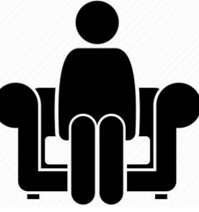




Physical activity is defined as body movement that expends energy and raises the heart rate.
Inactivity: less than 30 minutes physical activity a week (for adults); ‘less active’ is the term used for children, meaning less than 30 minutes of activity a day
Sedentary: time spent in low energy postures, e.g. sitting or lying
Everyday activity: includes cycling, walking, heavy housework, active or manual work, active travel
Active recreation: includes dance, yoga, active play, recreational walking or cycling
Sport: includes swimming, rowing, fitness training, climbing, parkour, tennis, organised sports
Strengthening activity: to develop muscle strength and build healthy bones in children; in adults and older adults helps to maintain strength and delay the natural decline in muscle mass and bone density
Notes:
Everybody Active Everyday PA Framework - https://assets.publishing.service.gov.uk/government/uploads/system/uploads/attachment_data/file/374914/Framework_13.pdf.

Slide 5
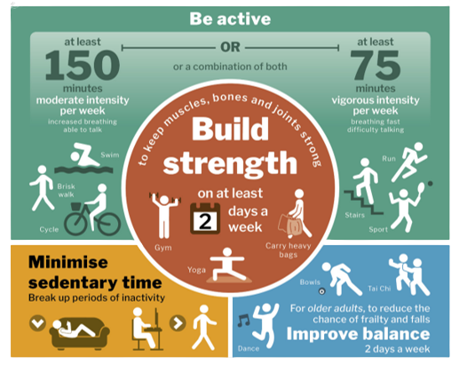
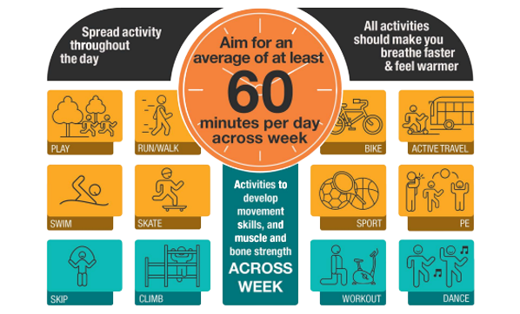
The UK CMOs’ guidelines provide clinical advice regarding the amount of physical activity people should do, and form the basis for government action.
An adult should have 150 minutes of moderate to vigorous physical activity per week.
A child or young person should have 60 minutes of physical activity per day.
Physical activity guidelines for children and young people (5-18 years)
Physical activity guidelines for adults
UK Chief Medical Officers’ Physical Activity Guidelines (2019)
Notes:
Sources:
All guidelines
UK Chief Medical Officers’ Physical Activity Guidelines. (2019). UK Chief Medical Officers' Physical Activity Guidelines (publishing.service.gov.uk)

Slide 6
By meeting the CMOs’ guidelines for physical activity, an individual may gain important health benefits, although the type of benefit will change with age.
Children | Adults | Older Adults
Bone health | All-cause mortality | Falls
Cognitive function | Stroke and heart disease | Frailty
Cardiovascular fitness | Hypertension | Physical function
Muscle fitness | Type 2 diabetes
Weight status* | 8 cancers
Depression | Depression
 | Cognitive function
 | Dementia
 | Quality of life
 | Sleep
 | Anxiety/depression
 | Weight status*
*See Annex – slide on weight loss
For example, for adults and older adults physical activity reduces risk of:
Type 2 diabetes by 40%
Cardiovascular disease by 35%
Falls by 30%
Depression by 30%
Joint and back pain by 25%
Colon and breast cancer by 20%
RHS: Based on UK Chief Medical Officers’ Physical Activity Guidelines (2019).

Slide 7
Tackling low physical activity can lead to significant improvements in mortality and morbidity through its direct effect but importantly also ameliorates other metabolic risk factors.
We know that low physical activity interacts with many other risk factors to produce negative health outcomes. On its own it is estimated to cause...
Based on 2019 England Global Burden of Disease data. Estimates are for each risk factor in isolation and do not account for interaction or indirect effects
The GBD data is the best source we are aware of for making comparisons between behavioural risk factors, but it is likely that it understates the importance of physical activity due to the methodology it uses.
It does not fully account for the indirect impacts that physical activity has on mortality and morbidity through intermediate risk factors such as high blood pressure, and it does not include all of the conditions that are know to be ameliorated by it, e.g. musculoskeletal conditions.

Slide 8
The combined health benefits of regular physical activity lead to an associated average increase in life expectancy of around 1 to 2 years.
Engaging in regular physical activity is associated with a longer life expectancy, irrespective of the presence of multiple long-term medical conditions.
A UK biobank study found that years of life gained at the age of 45 by multimorbidity status was:
Years of life gained
Physical activity levels | Multimorbidity Status
Total Physical Activity tertiles | With multimorbidity | Without multimorbidity
Moderate vs Low | 2 years | 1.8 years
High vs Low | 2.9 years | 1.8 years
Low activity = < 150 mins walking equiv. per week; Moderate activity = 150 to 750 mins walking equiv. per week; High Activity = > 750mins walking equiv. per week. Activity is all self reported physical activity
In addition to reducing mortality, increasing levels of physical activity can improve the quality of those years lived.
Based on information from Chudasama et al. (2020) and Marquez et al. (2020).
Notes:
Sources:
Impact of life expectancy UK Study
Chudasama, Y. V., Khunti, K. K., Zaccardi, F., Rowlands, A. V., Yates, T., Gillies, C. L., ... & Dhalwani, N. N. (2019). Physical activity, multimorbidity, and life expectancy: a UK Biobank longitudinal study. BMC medicine, 17, 1-13.
Physical Activity improves QoL
Marquez, D. X., Aguiñaga, S., Vásquez, P. M., Conroy, D. E., Erickson, K. I., Hillman, C., ... & Powell, K. E. (2020). A systematic review of physical activity and quality of life and well-being. Translational behavioral medicine, 10(5), 1098-1109.

Slide 9





Beyond ensuring good all-round health, being physically active also has wider social, community, and economic benefits.
Through investing £21.85 billion into community sport and physical activity in England a return on investment model revealed that the total impact on social and economic value was £85.5 billion made up of:
Regular physical activity in childhood is associated with improved learning and educational attainment.
Regular physical activity can increase workplace productivity and reduce absenteeism.
This means that:
Physical activity and sport can reduce crime and prevent/reduce antisocial behaviour, particularly in young people.
For every…
Generates nearly…
£1
£1
£1
£1
£1
“The UK could save 0.7% of total health care expenditure if everyone did at least 150 minutes of physical activity per week” (OECD-WHO analysis, unpublished)
…spent on community sport and physical activity
…for the English society and economy
LHS: Based on Sport England (2020), Measuring the Social and Economic Impact of Sport in England
RHS: Based on multiple sources
Notes:
Sources:
Social and Economic Benefit Statistics
Sport England. (2020). Social and economic value of community sport and physical activity. Measuring impact | Sport England
Improvement in learning and educational attainment
Public Health England. (2014). The link between pupil health and wellbeing and attainment: A briefing for head teachers, governors and staff in education settings. HT_briefing_layoutvFINALvii.pdf (publishing.service.gov.uk)
Improvement in workplace productivity and reduction in absenteeism
Robroek SJ, van den Berg TI, Plat JF, et al. The role of obesity and lifestyle
behaviours in a productive workforce. Occup Environ Med 2011; 68 (2); 134-139
van Amelsvoort LG, Spigt MG, Swaen GM, et al. Leisure time physical activity and
sickness absenteeism; a prospective study. Occup Med 2006; 56 (3): 210 – 212
Laaksonen M, Piha K, Martikainen P, Rahkonen O, et al. Health-related behaviours
and sickness absence from work. J Occup Environ Med 2009; 66: 840–847
Reduced crime and improved antisocial behaviour
van der Sluys, M. E., Zijlmans, J., Ket, J. C. F., Marhe, R., Popma, A., Scherder, E. J. A., & van der Laan, P. H. (2022). The efficacy of physical activity interventions in reducing antisocial behavior: a meta-analytic review. Journal of Experimental Criminology, 1-27.
Sport England. (2020). Social and economic value of community sport and physical activity. Measuring impact | Sport England
Healthcare care expenditure
WHO-OECD analysis. Due to be published in February Launch of WHO–OECD report on the burden of insufficient physical activity in Europe

Slide 10




A sizeable proportion of the English population is not physically active, and many adults and children do not get the amount of physical activity required.
Close to 4 in 10 adults do not achieve 150+ minutes of activity a week
Just over 5 in 10 children do not achieve an average of 60+ minutes of activity a day
Specifically, 12.4 million adults in England are inactive
In detail, 2.2 million children in England are less active
27.2%
30.1%
47.2%
61.4%
11.5%
22.7%
Based on Sport England (2022), Active Lives Adult Survey & Active Lives Children and Young People Survey

Slide 11


The UK does slightly worse than the OECD average on adult inactivity.
In 2016, more than 1 in 3 adults did not meet the recommended guidelines for physical activity on average across 36 OECD countries.
Worst |  | Best
Data Definitions:
Insufficient physical activity is defined as attaining less than 150 minutes of moderate‑intensity physical activity per week, or less than 75 minutes of vigorous-intensity physical activity per week.
Adults are individuals aged 18+ years
Notes:
Notes:
Comparisons cannot be made for physical activity statistics for adults aged 18+ years as data is not available. The OECD refer to data in their 2019 publication from 2014, looking at the proportion of the adult population who partake in moderate weekly physical activity but this is for individuals aged 15 years and over. (See here: 4dd50c09-en.pdf (oecd-ilibrary.org))
Sources:
OECD (2021), Health at a Glance 2021: OECD Indicators, OECD Publishing, Paris, https://doi.org/10.1787/ae3016b9-en.

Slide 12
The UK does slightly worse than the OECD average for child activity particularly for the older age group.
In 2017/18, just over 1 in 6 children met the recommended guidelines for physical activity on average across 27 OECD countries.
Worst |  | Best
Data Definitions:
Meeting recommended physical activity is defined as attaining at least 60 minutes of moderate-to-vigorous intensity physical activity daily.
Data are drawn from school-based samples of 1500 children in three age groups (11-, 13- and 15-year-olds).
Note: Data can be used to compare statistics at international level but due to differing methodologies see slide 8 for more robust English statistics.
Notes:
Notes:
Data is not available looking into international comparisons for children and physical inactivity statistics.
Data is not available for other age groups.
Sources:
OECD (2021), Health at a Glance 2021: OECD Indicators, OECD Publishing, Paris, https://doi.org/10.1787/ae3016b9-en.

Slide 13
Most recently trends of adults who meet physical activity guidelines have remained relatively stable, after seeing a steady increase for just over a decade.
Health Survey for England (HSE) data that uses consistent methods to obtain directly comparable measures between 2003 and 2016, shows that the proportion of adults meeting recommendations for levels of physical activity increased steadily over the 13 years.
The Active Lives Survey data (ALS) then shows that physical activity levels in the most recent years, firstly remained relatively stable, followed by a decrease after the pandemic (see Annex).
Methodological change to account for shorter exercise increases estimates
Data notes: In 2008, the module of questions on physical activity were revised and an enhanced questionnaire was developed for the HSE. This included additional questions to provide more accurate data on occupational activity and allowing bouts of 10 minutes of activity to be accrued towards meeting government physical activity recommendations. This is why the ‘revised’ data shows a higher proportion of adults meeting the government guidelines as the data includes these methods. Data using the original method is still shown for these time points so comparisons can be made to previous years. All HSE data is also not directly comparable with ALS data due to differing methodologies.
Notes:
Sources:

Slide 14
There has been no clear trend for children’s physical activity levels; differing data sources and methodologies make comparison over time difficult.
Early HSE data shows there has been little variation in children's physical activity levels between 2002 and 2007.
Between 2008 and 2012 trends show levels of physical activity fell by 6 percentage points. A slight increase was then seen between 2012 and 2015, but remained under 2008 levels.
The Active Lives Survey data (ALS) then shows that physical activity levels in the most recent years, firstly increased between 2017/2018 and 2018/2019, followed by a decrease after the pandemic. The most recent data time point (2021/2022) shows physical activity levels have recovered after the pandemic related decrease (see Annex).
Fully revised questionnaire to improve methodology reduces estimates
Differing methodology on more recent Active Lives Survey data does not allow for direct comparison
Data notes: In 2008, a fully revised module of questions on physical activity was introduced to the HSE to allow more accurate estimation of children’s activity; these questions have since been asked in 2012 and 2015. The questionnaire changes meant that HSE findings from previous years are not comparable with those from 2008 onwards. All HSE data is also not directly comparable with CYP ALS data due to differing methodologies.
Notes:
Sources:

Slide 15
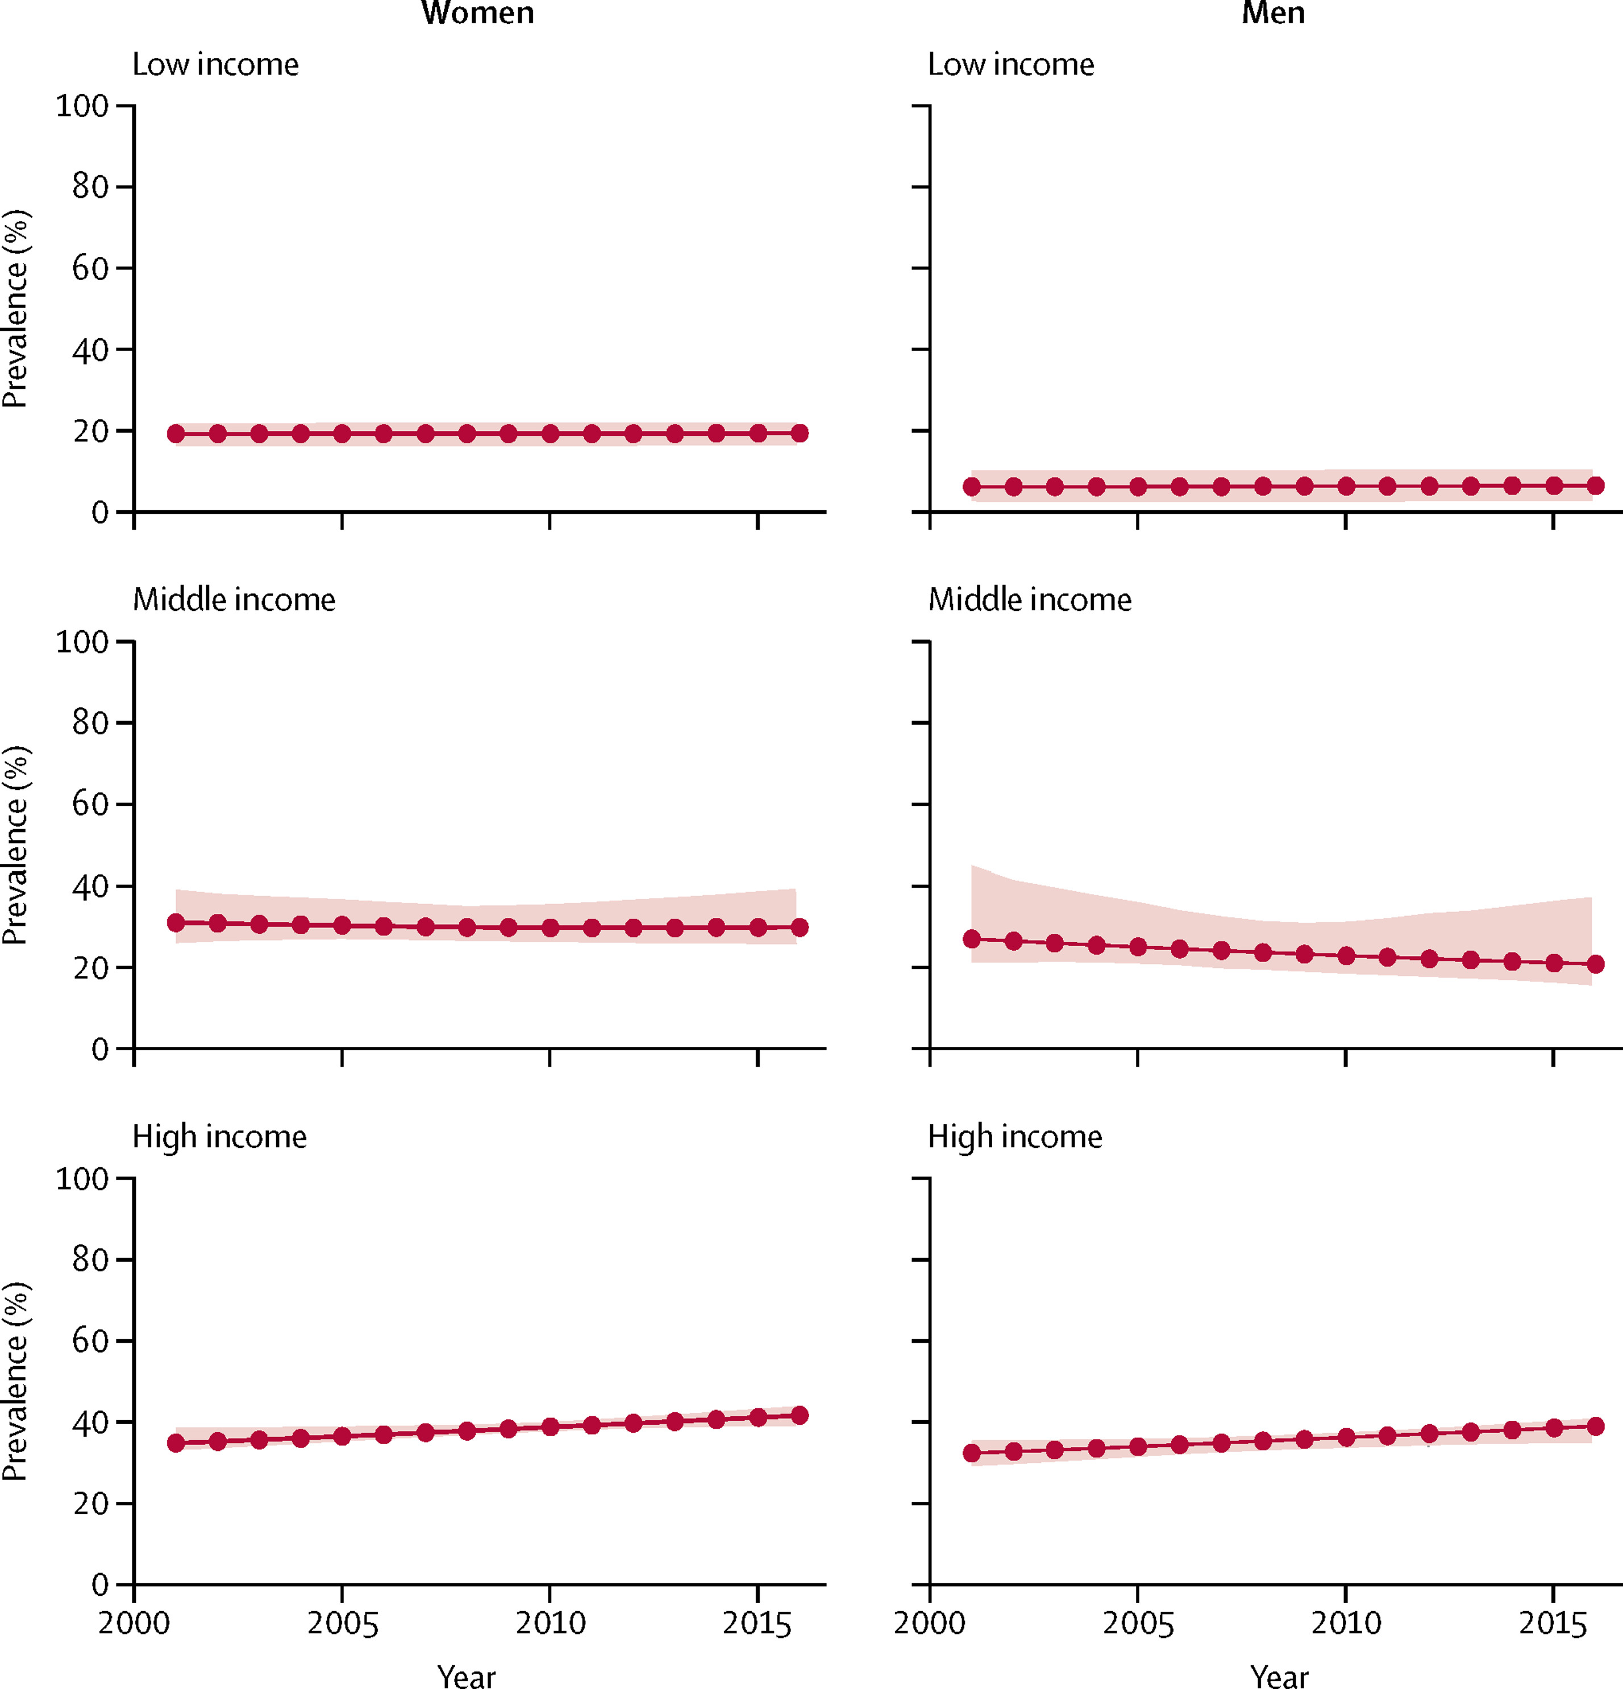
High income countries as a whole have seen a gradual worsening in the prevalence of insufficient adult physical activity, unlike the slight improvements in England.
Proportion of adults not meeting recommended levels of physical activity*
Between 2001 and 2016 global levels of insufficient activity were stable (change not statistically significant)
The prevalence of insufficient physical activity in high income countries increased from 31.6% in 2001 to 36.8% in 2016
To note - time series trends are based on modelled estimates using adjusted national survey data
*150 minutes of moderate physical activity or 75 minutes of vigorous physical activity per week – includes activity at work, home, active travel and leisure
Notes:
Source: Worldwide trends in insufficient physical activity from 2001 to 2016: a pooled analysis of 358 population-based surveys with 1·9 million participants - The Lancet Global Health

Slide 16



When choosing to partake in physical activity, the most common form of physical activity for adults is walking for leisure, which continues to see growth.
In the 12 months to Nov 21:
Trends for some activities have been altered compared to pre-pandemic levels (Nov 18-19):
Walking for leisure is the only activity to see a significant increase.
All other activity groups have seen a significant decrease.
Of those activities showing growth before the pandemic, only walking for leisure has continued to see numbers rise.
Fitness activities, sporting activities and active travel participation numbers remain below pre-pandemic levels.
Based on Sport England (2022), Active Lives Adult Survey
Notes:
Types of Physical Activity Data – Adult
Sport England. (2022). Active Lives Adults Survey, 2020-2021. Active Lives Adult Nov 20-21 Tables 6-8 Types of activity.xlsx
Types of Physical Activity Data – Children and Young People
Sport England. (2022). Active Lives Children and Young People Survey, 2020-2021. ALS CYP 21-22 Tables 5-14 Types of activity..xlsx (live.com)

Slide 17

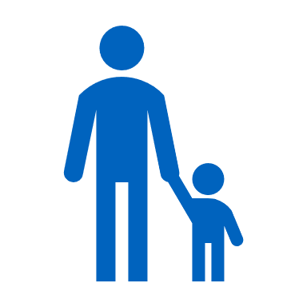
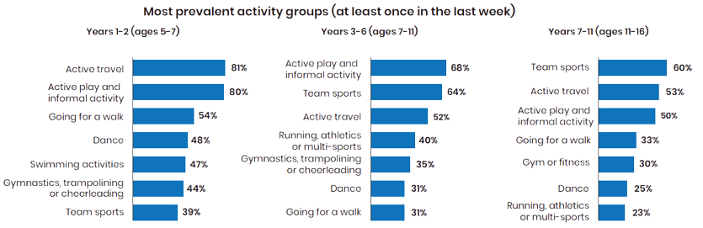
The most common form of physical activity for children and young people differs as they get older.
Active travel (81%), active play and informal activity (68%), and team sports (60%) are the most common activities done by infant age children (Years 1-2, ages 5-7), junior age children (Years 3-6, ages 7-11), and older age children (Years 7-11, ages 11-16), respectively.
Participating in team sports and gym or fitness activities are less common among younger children but gain in relative importance with age.
Going for a walk, dance, and swimming activities are more prevalent among the youngest children (Years 1-2, ages 5-7).
Based on Sport England (2022), Active Lives Children and Young People Survey
Notes:
Types of Physical Activity Data – Adult
Sport England. (2022). Active Lives Adults Survey, 2020-2021. Active Lives Adult Nov 20-21 Tables 6-8 Types of activity.xlsx
Types of Physical Activity Data – Children and Young People
Sport England. (2022). Active Lives Children and Young People Survey, 2020-2021. ALS CYP 21-22 Tables 5-14 Types of activity..xlsx (live.com)
Increase
Sporting activities
Active play and informal activities
Decrease
Going on a walk
Cycling for fun or fitness
Dance
Riding a scooter
Gym or fitness
No Change
Active travel

Slide 18
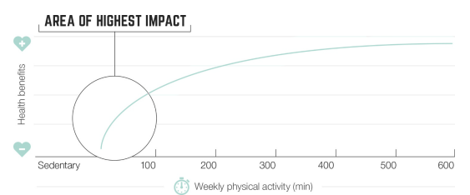


The greatest health gain comes from moving somebody from a physically inactive or low active status to a more physically active status.
Health benefits are achieved at levels both below and above the national guidelines; however, the targeting those currently doing the lowest levels of activity would deliver the greatest health benefits.
In England, latest statistics show that roughly 12.4 million adults are inactive and nearly 2.2 million children and young people are less active. These individuals would see the greatest health gains if they became more physically active.
At the upper end, higher levels of physical activity continue to provide health benefits and risk reduction continues, but begins to plateau beyond 300 minutes per week.
As the frequency and intensity of physical activity increases, there are small increases in health risk (e.g. accidents and injuries). However, the health benefits of activity far outweigh the risks of being active.
Chart: UK Chief Medical Officers’ Physical Activity Guidelines (2019).
Text: Based on information from multiple sources including, UK Chief Medical Officers’ Physical Activity Guidelines (2019) and Sport England (2022)
Notes:
Sources:
Health benefits of Physical Activity (Chart)
UK Chief Medical Officers’ Physical Activity Guidelines. (2019). UK Chief Medical Officers' Physical Activity Guidelines (publishing.service.gov.uk)
Health benefits of Physical Activity (Text)
UK Chief Medical Officers’ Physical Activity Guidelines. (2019). UK Chief Medical Officers' Physical Activity Guidelines (publishing.service.gov.uk)
WHO Guidelines on Physical Activity and Sedentary Behaviour. (2020). WHO guidelines on physical activity and sedentary behaviour

Slide 19
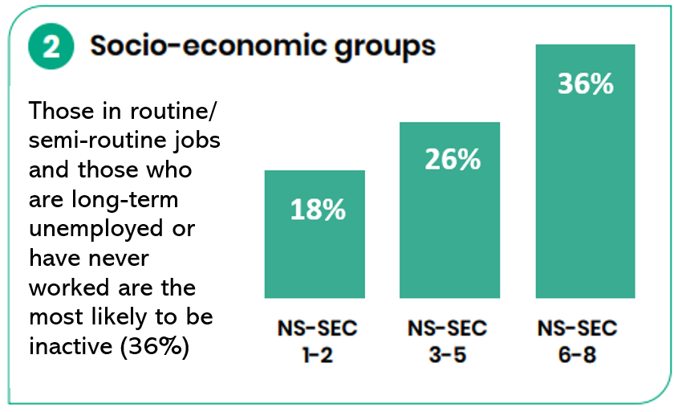
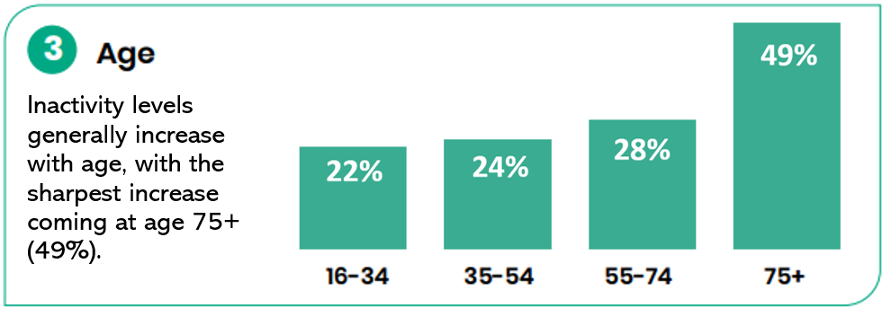
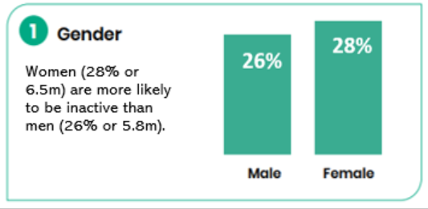
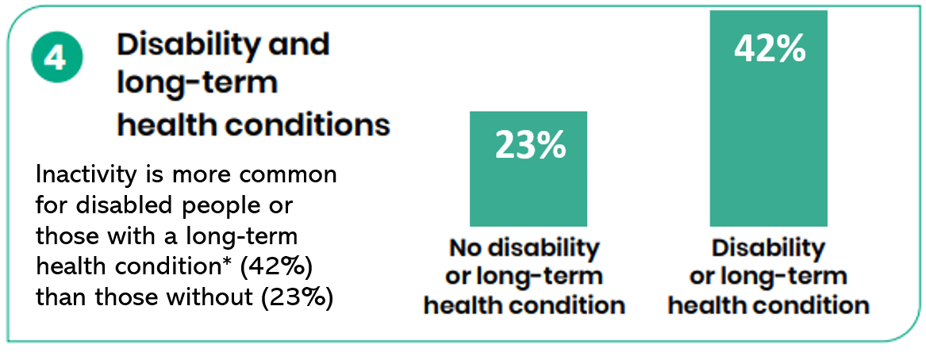
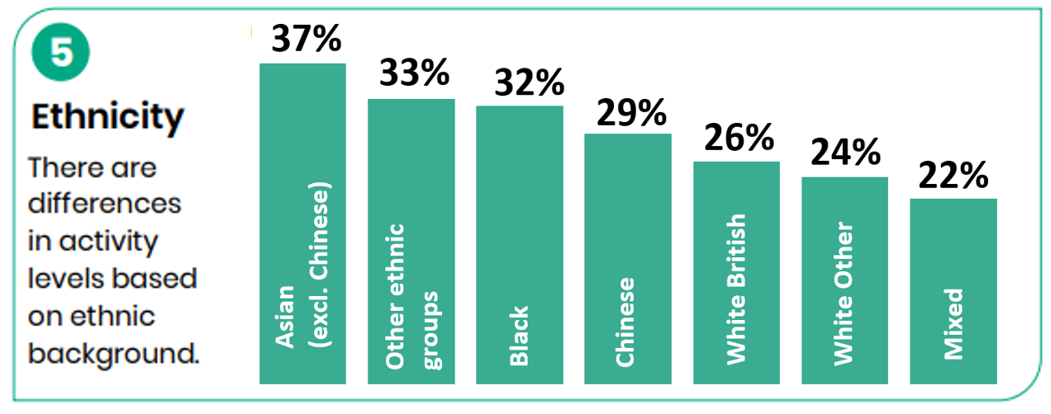
The 12.4 million inactive adults in England comprise people from the following groups:
Percentage of different groups that are inactive, i.e. completing less than 30 minutes of physical activity per week
There are differences in levels of inactivity based on ethnic background.
Sport England (2022), Active Lives Adults Survey
Notes:
To note that ALS Adults 21/22 data is available – this data is 20/21.

Slide 20
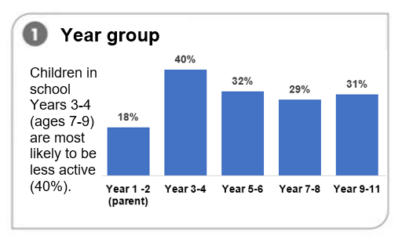
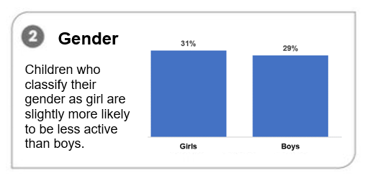
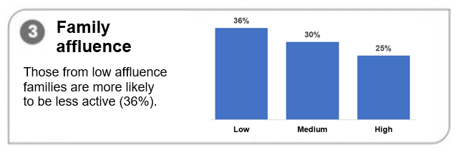
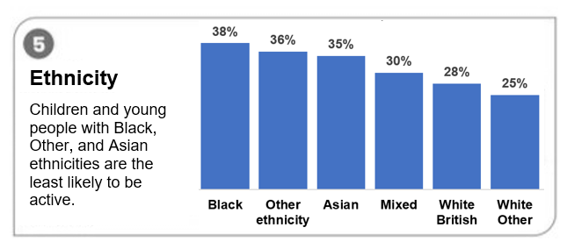
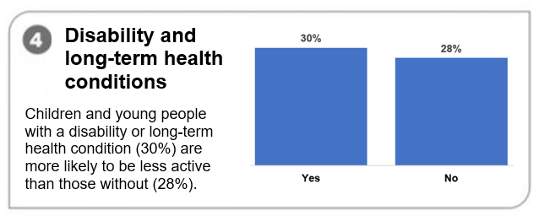
The 2.2 million children that are less active in England comprise children from the following groups:
Percentage of different groups that are less active, i.e. completing less than 30 minutes of physical activity per day
Sport England (2022), Active Lives Children and Young People Survey
Notes:
Children in Years 3-4 are most likely to be less active (40% or 560,300 children)
Children who classify their gender as girl or other are more likely to be less active (30.5% or 1,094,600 and 34.1% or 33,100 children respectively) than children who classify their gender as boy (28.8% or 1,068,300 children)
Children from low affluence families are more likely to be less active (35.6% or 534,100 children) than children from high affluence families (24.9% or 537,200 children)
Children with a disability or health condition are more likely to be less active (30.5% or 175,600 children) than children without (27.8% or 2,020,400 children)
Children with black or Asian ethnicities are more likely to be inactive than children who are white or from a mixed ethnic background

Slide 21
To understand the barriers to physical activity we have reviewed evidence from a range of sources.
We have established a series of population level and sub-group population level barriers to being physically active through a review of a range of existing data and literature.
Surveys
Systematic reviews
Barriers to participation
Commissioned research reports
Journal articles
Evaluation reports
The barriers identified may not be an exhaustive list, rather they are those cited by studies. It is not possible to rank barriers by impact due to varying methods between studies.

Slide 22




People know they should be active. However, there are multiple barriers acting at a population level that prevent people from being active.
Individual barriers
Cultural and social barriers
Structural and environmental barriers
Affordability and other economic barriers
Includes:
  Personal motivation
  Belief in capabilities
  Mental and physical health
  Moments in the life course of an individual where levels of physical activity may decline or stop
Includes:
  Lack of time
  Lack of role models
  Social cohesion
  Increased sedentary lifestyle due to technology
  Children’s activity levels are influenced by those of their parents
Includes:
  Lack of access to green and blue space
  Lack of access to safe spaces
  Personal safety concerns
  Seasonal changes
  Poor weather
  Access to/ lack of facilities
Includes:
  Cost of equipment
  Cost of leisure facilities
  Other financial pressures on an individual / household
Notes:
Garcia L, Mendonça G, Benedetti TRB, Borges LJ, Streit IA, Christofoletti M, Silva-Júnior FLE, Papini CB, Binotto MA. ‘Barriers and facilitators of domain-specific physical activity: a systematic review of reviews.’ BMC Public Health. 2022 Oct 26;22(1):1964. https://www.ncbi.nlm.nih.gov/pmc/articles/PMC9598005/
Koh, Y.S., Asharani, P.V., Devi, F. et al. A cross-sectional study on the perceived barriers to physical activity and their associations with domain-specific physical activity and sedentary behaviour. BMC Public Health 22, 1051 (2022)
https://bmcpublichealth.biomedcentral.com/articles/10.1186/s12889-022-13431-2

Slide 23
These population level barriers and their underlying causes can lead to unhealthy behaviours.
To support people to change their behaviour, we need to address these barriers, ensuring people have the necessary capability, opportunity and motivation to lead more active lives. Examples of how barriers can influence behaviours are as follows:
Individual barriers
Cultural and social barriers
Structural and environmental barriers
Affordability and other economic barriers
Lack of confidence and capability can prevent people from being active. This may lead to a further loss in confidence and embed inactive behaviour.
Lack of time could mean that people are more likely to travel by car to get somewhere quickly or easily, or that they are less likely to use what little leisure time they have to exercise.
Lack of infrastructure to support active travel, (such as pavements and cycle lanes), makes it more likely people will drive or use another form of inactive transport.
High cost of leisure facilities could mean people are less inclined to exercise in the colder months, or at all if they also don’t have access to public parks.

Slide 24
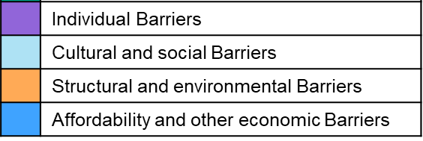
Within the population level barriers, there are particular barriers that prevent our identified groups of inactive adults and less active children from being physically active.
Children and adults from more deprived backgrounds and from ethnic minorities face a variety of similar social and cultural barriers, and people with disabilities and long-term health conditions often cite pain and lack of energy as an obstacle. Women and girls face differing barriers at points in their lives such as teenage years, pregnancy, menopause.
People from more deprived socio-economic backgrounds
Lack of confidence
People from ethnic minorities
Cost
Time
Lack of culturally appropriate facilities
Lack of role models and family/community support
People with disabilities
Health/ impairment
Lack of confidence and motivation
Behaviour/ attitude of others
People with long term conditions
Pain & lack of energy
Concern physical activity will worsen condition
Awareness of where to go
Older people
Social isolation
Risk of injury/ fall
Existing physical health conditions
Previous PA habits
Unpredictable nature of the LTC
Gender (women, transgender and non-binary people)
Pregnant/post-partum women – tired, time, childcare
Transgender or non-binary - Changing rooms concern
Transgender or non-binary – Lack of safe spaces
Language and culture
Cost
Teenage Girls
Safety and harassment
Body image / self-esteem, “not sporty”
Pain and lack of energy
Breathlessness
Midlife women – menopausal symptoms, time
Transgender or non-binary - Fear of non-acceptance and bullying
Barriers
Notes:
REFERENCES/RESEARCH
Overarching docs
Understanding and addressing inequalities in physical activity- Evidence- based guidance for commissioners. August 2021. PHE, London.
Barriers systematic review - s12889-022-14385-1.pdf
Review of systematic reviews around barriers to PA
Barriers and facilitators of domain-specific physical activity: a systematic review of reviews - PubMed (nih.gov)
Specific Population groups
LES
ALS Adult nov 20-21 Lower socio-economic groups | Sport England.
Plus CS said SE had a report which set out the barriers for this group – looking for it now
EM
Microsoft Word - BME Final Report-v-2.doc (sportengland-production-files.s3.eu-west-2.amazonaws.com)
Disability
Inclusive recovery – Activity Alliance Oct 22 Inclusive recovery report: "Include me as we return to activity" | Research | Activity Alliance
Disability alliance – 2012 Understanding_the_barriers_to_participation_20120510_original.pdf Understanding the barriers to participation in sport | Activity Alliance
Annual disability and Activity survey – 2021-22 Annual Disability and Activity Survey 2020-21 | Research | Activity Alliance
Perceived barriers and facilitators to physical activity for children with disability: a systematic review
https://bjsm.bmj.com/content/46/14/989
LTC
We are Undefeatable – We Are Undefeatable | Sport England
Richmond Group research - PowerPoint Presentation (richmondgroupofcharities.org.uk)
Women and girls
Teenage years
Reframing Sport for Teenage Girls: Tackling Teenage Disengagement - Women In Sport
Barriers-1.jpg (2269×993) (womeninsport.org)
Pregancy/post-natal
Attitudes, barriers and enablers to physical activity in pregnant women: a systematic review - PubMed (nih.gov)
Physical activity beliefs, barriers, and enablers among postpartum women - PubMed (nih.gov)
Peri/menopause
WIS_TDA33921_Menopause-Research-Midlife-Model_004 (womeninsport.org)
Older – see NZ doc
Active-Ageing-an-Anchor-Hanover-report-in-association-with-Demos.Final_.pdf – disability, lack of energy, SOB, pain
spotlight-on-older-adults.pdf (sportengland-production-files.s3.eu-west-2.amazonaws.com) Nov 16-17
ukactive_Life_Fitness_Moving_More_Ageing_Well-Report.pdf
LGBT
Inequalities report – see above
Survey-of-Exercise-Physical-Activity-in-LGBT-Lives-in-England.pdf (blgbt.org)
Barriers and facilitators of physical activity and sport participation among young transgender adults who are medically transitioning
https://core.ac.uk/download/pdf/288368628.pdf
The Levels and Predictors of Physical Activity Engagement Within the Treatment-Seeking Transgender Population: A Matched Control Study
https://pubmed.ncbi.nlm.nih.gov/28872406/
Stonewall and Mermaids – Written evidence to Parliament 2021
https://committees.parliament.uk/writtenevidence/22247/pdf/
Out in Sport LGBT Students’ Experiences of Sport
https://nusdigital.s3.eu-west-1.amazonaws.com/document/documents/60235/e7ce309bf7351ca03a191864a0510b22/Out_in_Sport_LGBT_student_experiences_of_sport_in_FE_and_HE.pdf?X-Amz-Expires=10000&X-Amz-Date=20230307T155505Z&X-Amz-Security-Token=IQoJb3JpZ2luX2VjEHYaCWV1LXdlc3QtMSJHMEUCICK7qmDVgaoxp4t3LaCnmEhLm3hGf4UPq65nUAKzBSeNAiEA%2BAE3OpqtOyHFRGd5hHV1RS68%2BYtEqCxdYY38ad%2BGd%2BcqiQQILxAAGgw4NzkyMjgzNDAzMzgiDG2EsP4NlNsGxXPpLirmA7dFbH8ghQlSSQ9ukEznUuxPAadg%2B9n98VriID7BNHT3ZAuSIq3IeRJpy7zCIYPCW%2FMJwTU6YuObWcZJnPg1iXnhNTl2NBP0kMpYQJBVS17PsIqGIVrki50G61pyHBQQSMOoGtpKSDExq%2Bau81EbVG0EFLCKNg%2FnsXAToH28N13%2F2%2BFt%2FEa0cT%2BklAwQ%2Bf%2F67%2FFJU82jNExs5VF%2Fx0%2F%2Bd%2FZCM4OY8oW%2F7Wkisub1CJr%2Br0AlL%2Ba7ot6yeq5ufJoaIlZAyKYkSAvmGs2MPS%2BOdJJnbBfnfwUpNBmpc9%2BmyaakuTqijAnROtVhp7bUQ6PQJvTWNyIVsf%2BHMf1nk44lrFXtUD5XYrHjEXhGFwhvi4Nu6R35FLFtLAIMD%2BLFC4YBbiFxM%2BQMLxi%2BOzxFOY%2Bw4Dpr1yK84PyNdZAHL6B0aBWsGmvSXI1QhC66CML3TW1UUK9yimOcDLdUBWZhnk8aznv635jdnP9igOACKoR%2FUGMUgmFSu0SQ9uk6bYM4cSO1Dm%2Be3rtL8PqUuXf28PmaU1plPTg8M%2Fgjgw5YZLlL0mHKAGJUWSMB7zAlmzdEFnTp8w9X4LO8MiJs6swM4rZ3n%2Bopm0uIEE0UZ3EfzlSDw1jULvB7QQInfD4lAZmvyNYOG8UKajeDPDCsi52gBjqlAfGSFGMlpwdFcLg%2F13g16TMO6NWZ6vSHtjiaFxwflVzSO3wI7rExttiJ36eJQ4u9vRJIwytar%2Bk%2BZfgpu%2FdGbBbDxxXaCxjWZTu6Nk8NDcrjeCiWPpB1PlSFf5FXA4wWzw52OIGasZcMcPjRV4zbrVkjRCh7sS9FBqT6CgOKAjJGT9oSF5SXhwMEYk9R66RzmN%2Fq%2BbzL0jfNao37AS4YsQs%2Fd4sXig%3D%3D&X-Amz-Algorithm=AWS4-HMAC-SHA256&X-Amz-Credential=ASIA4ZNQXZBZLGOEWC5J%2F20230307%2Feu-west-1%2Fs3%2Faws4_request&X-Amz-SignedHeaders=host&X-Amz-Signature=039a8866cea370001342c2841a152c203b59a2d6e91ac8940606f659362d7e42

Slide 25




Eight areas have been shown to be effective internationally when used in combination to make, help and support people to be physically active.
Due to the differing contexts between countries, a tailored approach is required, following assessment of the existing issues. We have roughly mapped these against population level barriers, but we will do a more detailed assessment of the impact against these barriers as part of Part 2.
Whole school programmes
Active transport
Healthcare
Active (urban) design
Regular, quality, PE classes
Replacing short car journeys with cycling
Availability of opportunities for recreational activity
Targeting PA solely and/ or combined with other modifiable risk factors.
Suitable environments and resources
Active travel to school programmes
Walking / stairs to and from public transport
More destinations, shorter distances, and better active travel infrastructure
HCPs/social prescribing provide brief advice; referral & signposting to digital/local opportunities and raising awareness of PA as part of treatment.
Multiple components shown to have a longer term impact on PA levels.
Effective interventions include: destination accessibility, equitable distribution of employment across cities, reducing availability and increasing cost of parking, pedestrian and cyclist friendly infrastructure, reducing distance to public transport
Public education
Campaigns to enable behaviour change; heighten awareness of health benefits of regular PA, according to ability and target audience
Sport and recreation for all
Mass sporting events, mass communication campaigns and enhancing visibility of elite sportspeople promote participation in sports
Workplaces
Policies include workplace environment design; active commuting; physically active social activities; paid or flexible time for PA
Community-wide programmes
Targeted at a more local level and deploy a system-wide approach
Limited effect on PA levels without supporting opportunities.
Target opportunities to groups where participation rates are lowest
Most successful where workplaces have embedded a culture of wellness
Ensure equitable access to facilities and amenities
Best practice is to frame messaging positively; target to groups; use formative research, behavioural/psychological theory and social marketing principles
Effective at increasing population levels of PA as they target different types of PA, work, active travel and recreation
Notes:
​Source: ISPAH Eight Investments that work for physical activity
9789241514187-eng.pdf (who.int)

Slide 26
OHID, OGDs and a range of other agencies provide a range of existing policies to promote and drive up rates of physical activity.
Community-wide programmes
Healthcare
Whole school programmes
Workplaces
Clinical Guidance across health improvement and clinical care and management, much of which includes physical activity. Owner: NICE
Healthcare Professionals Training and CPD support includes training on physical activity. Owner: NHSE & Health Education England
The Moving Healthcare Professionals Programme supports healthcare professionals to promote physical activity within their daily practice. Owner: OHID with NHSE, Sport England
The NHS Health Checks programme supports people at risk of CVD, including from physical inactivity, to make changes and access care. Owner: OHID with NHSE
The Primary School PE and Sports Premium, and the Sports and Games Organiser Network which support children to be more active before, during and after school time. Owner: OHID with DfE, DCMS, Sport England
Better Health Rewards pilot to assess whether financial incentives can be used to improve adult physical activity levels and diet quality. This pilot has a focus on underserved groups.
Regional and place-based approaches facilitate and bring together networks, generate & share learning, inform strategies & local practice to integrate physical activity opportunities.
Owner: OHID and regions with Local Authorities, NHS and VCSE
The Joint Work and Health Unit promote evidence to improve practice to support health of workforce; includes specific action on MSK, integration of physical activity into heathy workplace programmes. Owner: DHSC with DWP
Public education
Active travel
Enabling businesses to promote active travel; social prescribing programme to promote walking and cycling. Owner: DfT & Active Travel England
Implementation of Gear Change Strategy to help improve the cycling environment and infrastructure and encourage and enable people to cycle. Owner: DfT
Active (urban) design
Access to open spaces, sports facilities and promotion of walking, cycling and public transport through National Planning Policy Framework and guidance. Owner: DLUHC
Sport and recreation for all
Green social pilot to promote nature & green space. Owner: Defra
Development of a x-gov sport strategy recognising the importance of sport and physical activity; investment in sports facilities. Owner: DCMS
Better Health campaigns to encourage adults to increase their activity levels, including 10 Minute Shake Up and digital behaviour change interventions (e.g. Couch to 5k, Active 10, 12 week weight loss app). Some campaigns are more targeted to certain groups. Owner: OHID

Slide 27
Physical activity has important health benefits. However, 12.4m adults are inactive and 2.2m children are less active.
Through physical activity, an individual may gain important health benefits, although the type of benefit will change with age. For example, physical activity can reduce the risk of Type 2 diabetes and depression in adults.
The greatest health gains come from improving activity levels for those who are inactive.
England’s physical activity levels are stable, though below the OECD average.
Physical activity levels for both adults and children decreased slightly with the onset of the Covid pandemic.
There are multiple barriers preventing people from being more active, but also good evidence that policies and interventions can be effective at tackling some of these.
Common barriers across the population include individual, social and cultural, structural and environmental, and economic factors. These barriers can drive inactive behaviours.
Notes:
This was the summary of the first presentation to Jeanelle

Slide 28
Population levels of physical activity suggest that the Government’s current suite of policies is maintaining rather than increasing physical activity.
We know that the greatest health gains come from improving activity levels for those who have the lowest levels of activity. Therefore, our focus should be on policies that are targeted at this group.
We will use our next meeting with you to provide a more detailed review and analysis of the barriers and required policies. This will include consideration of the following questions:
Which barriers are the primary blockers for the 12.4m adults who are inactive and 2.2m children who are less active?
To what extent are these barriers behavioural or environmental?
Which interventions (if any) successfully address and overcome these barriers?
What is the level of impact of relevant current policies on addressing these barriers for this group?
Are the eight internationally evidenced areas for intervention sufficient to address these barriers?
What levers for change are required and who owns them?
Where are there gaps / policy opportunities for the future?
What is the role of OHID in reducing levels of physical inactivity?

Slide 29
Part Two
A focus on the evidence for policy effectiveness and impact
Notes:
DD DATE SOMEWHERE

Slide 30
Initial analysis of drivers of inactivity.

Slide 31



Societal changes over the years have highly affected physical activity trends.
“People in the UK are around 20% less active now than in the 1960’s.” (OHID, 2022)
This is mainly due to societal changes having designed physical activity out of our lives and we now need to make a conscious decision to build physical activity into our daily lives.
Societal changes that have been found to impact physical activity levels include:
Employment and Occupational Changes
Manual jobs have declined in employment share and have been replaced with technology, such as robotics and artificial intelligence. From 1981 to 2008 routine manual jobs declined by 50.4%. In addition, the prevalence of office jobs has increased, where it has been found that workers can spend three-quarters of the workday in sedentary behaviour (Ryan et al., 2011)
Changes in Household Activities
Technology now dominates in the home and with labour-saving technology (for example, vacuum cleaners, washing machines etc.), less time and energy is devoted to housework and other moderate-level activities in the home.
Changes in Travel Behaviour
Increasing car use is a major factor to lower levels of physical activity in the UK (PHE, 2016). Broadly, since 1950, UK transport has become car-centred, with statistics showing majority of travel is undertaken by car (around 92% of distance travelled in the UK in 2015; Foresight, Government Office for Science, 2019). Additionally, cycling has declined substantially over the years from 13% of distance travelled in 1952 to less than 1% in 2015 (Foresight, Government Office for Science, 2019).
Majority of information is from: OHID (2022), Physical activity: applying all our health.
Public Health England (2016). Health matters: getting every adult active every day
Notes:
Ryan, C. G., Dall, P. M., Granat, M. H., & Grant, P. M. (2011). Sitting patterns at work: objective measurement of adherence to current recommendations. Ergonomics, 54(6), 531-538.
Foresight, Government Office for Science. (2019). Decision-Making in the UK Transport System. https://assets.publishing.service.gov.uk/government/uploads/system/uploads/attachment_data/file/773667/decisionmaking.pdf

Slide 32
What does the evidence tell us are the most effective ways to reduce inactivity levels?

Slide 33
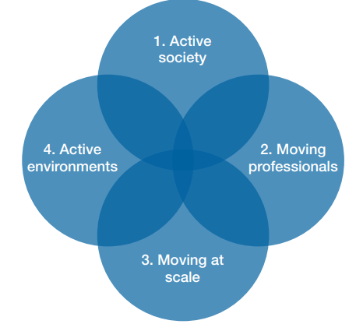
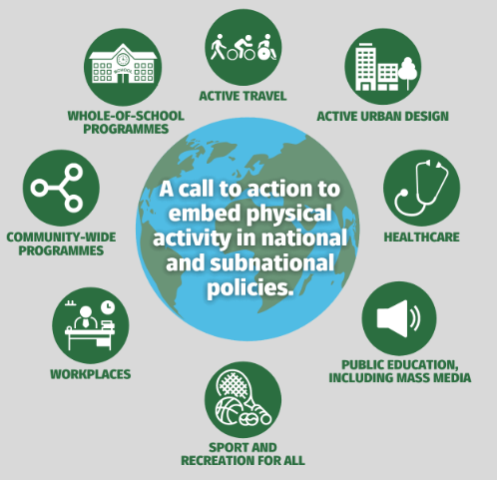
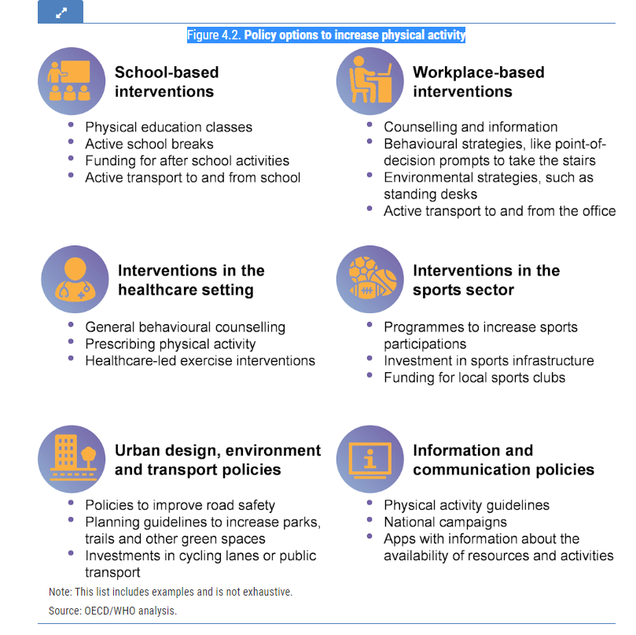

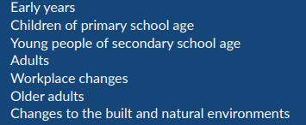

Frameworks have been developed and deployed by governments and international bodies to set out the evidence for action to improve activity rates.
This started in 2014 with the Everybody Active, Every Day framework, with others developed reflecting this original approach across the world.
2019: Moving Matters: Intervention to Physical Activity – NIHR (UK)
2020: 8 investments that work for physical activity – ISPAH (intl)
2023: Step Up! Tackling the Burden of Insufficient Physical Activity in Europe – OECD (intl)
2014: Everybody Active, Every Day – PHE (UK)
2018: Global Physical Activity Action Plan – WHO (intl)
2021: Uniting the Movement – Sport England (UK)

Slide 34








The evidence shows that there are choices for intervention across the range of domains, which represent internationally recognised best practice for improving rates of activity across population groups.
Community-based programmes
Healthcare
Active travel
School-based programmes
Active design and planning
Campaigns
Workplaces
At a more local-level, community programmes include a range of different programmes and can be tailored to the particular needs of a community or groups within a community.
Healthcare professionals come into contact with large proportions of the population. Ensuring they understand the benefits of physical activity and that they have schemes to signpost/refer into, is essential to enabling them to support their patients accordingly.
Travel takes up a relatively large proportion of people’s daily time. Integrating more physical activity into transportation is a practical and sustainable way to increase activity levels.
Children spend more time in school than anywhere else other than home. In addition, schools serve children from across the population. Maximising opportunities in and around the school day for physical activity can significantly increase children’s activity levels.
Social marketing campaigns and assets, which encompass print, audio, TV and social media, outdoor billboards and more, campaigns are an effective way to transmit consistent and clear messages about physical activity.
The way cities, towns and rural areas are built and designed impacts options for activity and influences behavioural choices. How neighbourhoods are designed can increase physical activity. This includes transport infrastructure, and green and blue public spaces.
Workplaces are an opportune setting for increasing activity levels as most adults spend at least a third of their day at work. This is especially important as workplaces have tended to become more sedentary in recent years with the automation and computerisation of work.
Sport and recreation for all
This includes mass sporting events, mass communication campaigns and enhancing visibility of elite sportspeople to promote participation in sports and create role models.
Ensuring equitable access to facilities and amenities.

Slide 35
Within England currently, we are undertaking policy action across all of these domains. These are being delivered by OHID, OGDs and other partners.
Community-based programmes
Healthcare
School-based programmes
Clinical Guidance across health improvement and clinical care and management, much of which includes physical activity. Owner: NICE
Healthcare Professionals Training and CPD support includes training on physical activity. Owner: NHSE & Health Education England
The Moving Healthcare Professionals Programme supports healthcare professionals to promote physical activity within their daily practice. Owner: OHID with NHSE, Sport England
The NHS Health Checks programme supports people at risk of CVD, including from physical inactivity, to make changes and access care. Owner: OHID with NHSE
The Primary School PE and Sports Premium, and the Sports and Games Organiser Network which support children to be more active before, during and after school time. Owner: OHID with DfE, DCMS, Sport England
Better Health Rewards pilot to assess whether financial incentives can be used to improve adult physical activity levels and diet quality. This pilot has a focus on underserved groups.
Regional and place-based approaches facilitate and bring together networks, generate & share learning, inform strategies & local practice to integrate physical activity opportunities.
Owner: OHID and regions with Local Authorities, NHS and VCSE
Local Delivery Pilots in 12 communities in England designed to tackle barriers to inactivity for specific inactive groups. Owner: Sport England
Campaigns
Better Health campaigns to encourage adults to increase their activity levels, including 10 Minute Shake Up and digital behaviour change interventions (e.g. Couch to 5k, Active 10, 12 week weight loss app). Some campaigns are more targeted to certain groups. Owner: OHID
Active travel
Enabling businesses to promote active travel; social prescribing programme to promote walking and cycling. Owner: DfT & Active Travel England
Implementation of Gear Change Strategy to help improve the cycling environment and infrastructure and encourage and enable people to cycle. Owner: DfT
Active design and planning
Access to open spaces, sports facilities and promotion of walking, cycling and public transport through National Planning Policy Framework and guidance. Owner: DLUHC
Workplaces
The Joint Work and Health Unit promote evidence to improve practice to support health of workforce; includes specific action on MSK, integration of physical activity into heathy workplace programmes. Owner: DHSC with DWP
Sport and recreation for all
Green social pilot to promote nature & green space. Owner: Defra
Development of an across-government sport strategy recognising the importance of sport and physical activity; investment in sports facilities. Owner: DCMS
Notes:
These are our current policies to improve activity levels. They are delivered by OHID, other government departments and ALBs.
The text in purple are policies that are designed to target the groups we have identified previously as requiring additional support to be active.

Slide 36




Based on our review of the evidence bases and our specific objective of targeting adults that are inactive and children that are less active, four areas emerge as priorities.
School-based programmes
Healthcare
Active Travel
Community-based programmes
At a more local-level, community programmes include a range of different programmes but are tailored to the particular needs of a community or groups within a community.
Children spend more time in school than anywhere else other than home. In addition, schools serve children from across the population. Maximising opportunities in and around the school day for physical activity can significantly increase children’s activity levels.
Healthcare professionals come into contact with large proportions of the population. Ensuring they understand the benefits of physical activity and that they have schemes to signpost/refer into, is essential to enabling them to support their patients accordingly.
Travel takes up a relatively large proportion of people’s daily time. Integrating more physical activity into transportation is a practical and sustainable way to increase activity levels.
Notes:
We propose four areas to focus where we do more.
We have done this based on four factors:
Case studies of good, impactful practice
Broad-based or systematic evidence of impact
Transferability / relevance to England
Relevance to inactivity and our priority groups. NB
We have included domestic and international effective examples for improving activity levels in each domain.
Important to note that there are interactions between policy approaches and interventions across the 8 domains.
For instance, healthcare, whether through a GP, nurse or social prescribing can signpost people to activities in the community, which could include walking clubs and/or sporting and recreation interventions such as walking football.
Domains such as social marketing campaigns promote physical activity opportunities in community settings, such as Better Health, and some campaigns help to tailor messages and amplify reach to particular population groups such as 'We are Undefeatables'. The Better Health Campaign provides consistent branding which can reinforce messages and enables local action to dovetail with national media – Better Health rewards pilots is actively using branding to test Better Health Rewards in Wolverhampton. DHSC and Disney '10 Minute Shake up' provides fun games to support children, get active in school and at home with their families. Such campaigns also
Published in February 2023, the OECD report Step Up! Tackling the Burden of Insufficient Physical Activity in Europe | OECD iLibrary (oecd-ilibrary.org) provides an evidence and practice based guide to the policy options to increase physical activity.
The report sets out the options and acknowledges that all policies have their own benefits and that it is unlikely that any single policy will have a major impact on physical activity levels in the population.
The analysis indicates that previous OECD modelling work showed how a physical activity policy package including interventions such as prescribing physical activity, investing in active transport and school-based programmes can lead to significant health gains and savings in health care expenditure. Such a package of policies aimed at increasing physical activity, implemented in 36 countries, would prevent 38 000 NCDs per year and save around EUR 14 billion in health cost by 2050 – equivalent to the total annual health care expenditure of Greece.
The report concludes that the task at hand is clear: make physical activity a public health priority to improve health and reduce the burden of non-communicable diseases. However, to achieve such a goal, much work remains. Rather than falling under strategies for other risk factors, physical inactivity should be a separate and equal concern, and should be recognised as a unique specialty. A strong policy framework, consistent investment in physical activity programs and infrastructure, multi-sectoral support, high population reach, and good surveillance should characterise each future action (Pratt et al., 2015[44]). Adaptation of the evidence-based strategies to community need, culture, and context is critical. An isolated public health strategy for physical activity is unlikely to be successful as many of the necessary actions occur in sectors other than public health and because sustained funding is nearly impossible without the broader political support associated with strong partners.

Slide 37

Physical activity is critical for children’s development, mental and physical health and improving attainment, so school-based programmes are important interventions to increase activity rates.
In children, physical activity is critical for motor development, cognitive improvement, psychosocial and cardio-respiratory health, reducing body fat and helping to increase academic achievement. This is essential for healthy development of muscles, bones and cognition.
Evidence suggests that there is an association between being physically active and academic performance, learning and attention. However, this is complex: it is not a linear association in that the more physically active a young person is the better their academic performance; other factors of course play a part. We do know that being physically active helps to promote physical and emotional health and wellbeing. Children and young people who are physically active are more likely to continue the habit into adult life.
Ofsted found 55% of parents agreed that their children’s school had helped make their child make healthier choices about physical activity. Further, schools were found to impact on physical activity levels outside of school, with 56% of pupils reporting they did activities at home because of what they learned in school.
National and international guidance recommends whole-school approaches to physical activity.
Notes:
Cochrane review states that - This is a topic of concern, particularly because it is known that physical activity patterns in childhood can lead to similar patterns in adulthood
School‐based physical activity programs for promoting physical activity and fitness in children and adolescents aged 6 to 18 - Neil-Sztramko, SE - 2021 | Cochrane Library
PHE – 2020 What works in schools and colleges to increase PA? States that -Developing regular physical activity behaviours in childhood is crucial as we know that children who are active are more likely to become active adults and continue to reap the benefits of an active lifestyle throughout their life course - Guidance to increase physical activity among children and young people in schools and colleges (publishing.service.gov.uk)
Research feeding into the statement above includes:
Physical activity from childhood to adulthood: a 21-year tracking study - Physical activity from childhood to adulthood: a 21-year tracking study - PubMed (nih.gov)
UK CMO PA guidelines – pp 25-28 plus references UK Chief Medical Officers' Physical Activity Guidelines (publishing.service.gov.uk)
Whole schools approach research https://www.mdpi.com/1660-4601/19/24/16950/pdf
Laverty AA, Hone T, Goodman A, Kelly Y, Millett C. Associations of active travel with adiposity among children and socioeconomic differentials: a longitudinal study. BMJ Open. 2021 Jan 1;11(1):e036041.​
McKay A, Goodman A, van Sluijs E, Millett C, Laverty AA. Cycle training and factors associated with cycling among adolescents in England. J Transp Health. 2020 Mar;16:100815.​
Breheny K, Passmore S, Adab P, Martin J, Hemming K, Lancashire ER, et al. Effectiveness and cost-effectiveness of The Daily Mile on childhood weight outcomes and wellbeing: a cluster randomised controlled trial. Int J Obes. 2020 Apr;44(4):812–22.

Slide 38
Domestic and international examples of effective school-based interventions.
Daily Mile, across the UK
The programme is delivered in primary schools and encourages all children to run or jog at their own pace outside for 15 minutes each day. The programme is free to schools and does not require any specialist equipment, uniforms or teacher training.
Target group: school children, aged 3-12
Impact: evidence suggests the Daily Mile increases levels of physical activity in children, and can lead to improvements in social, mental and emotional health. It is reaching over one million children, particularly in urban and deprived areas of England
On average 50% of children aged 4-7 are able to run one mile, 25% more than a mile and 25% less than a mile. For children aged 8-12, 50% can run one mile, 40% more than a mile and 10% less than a mile.
Additional research (iMprOVE study) is underway to examine the impact of school-based physical activity initiatives on children’s health and wellbeing across primary school life where primary schools take place in active mile initiatives.
Finnish Schools on the Move, Finland
Started in 2010, it aims to increase physical activity during the school day (including during lessons and breaks), promote active travel to and from school, and enable participation in a leisure activity after school.
Target group: all children at school
Impact: the programme is now used in over 90% of Finnish comprehensive schools. In participating schools, 77% of students took part in physical activities during the school day.
Notes:
Active Mile
AM examples Active mile briefing: practice examples (publishing.service.gov.uk)
AM evidence and policy summary Active mile briefing: evidence and policy summary (publishing.service.gov.uk) [rapid review]
AM Annex A the evidence for the AM Active mile briefing: evidence and policy summary - Annex A (publishing.service.gov.uk)
Daily Mile
Daily Mile website The Daily Mile | UK
Daily Mile research The science behind The Daily Mile | The Daily Mile UK
Been running for almost 11 year - began April 2012
Infographic on the benefits of the Daily Mile Benefits-of-Physical-Activity-How-The-Daily-Mile-Can-Help.pdf (thedailymile.co.uk)
The Daily Mile is reaching over one million children, particularly in urban and deprived areas of England | The Daily Mile UK
RCT on the DM Effectiveness and cost-effectiveness of The Daily Mile on childhood weight outcomes and wellbeing: a cluster randomised controlled trial | International Journal of Obesity (nature.com)
Cochrane review 2022 - do school based PA interventions increase MVPA among children and adolescents?
Do school-based physical activity interventions increase moderate to vigorous physical activity and improve physical fitness among children and adolescents? | Cochrane
School-based interventions may improve physical fitness
but may have little to no impact on body mass index
Careful consideration is needed about the type of school-based physical activity programme to be implemented, and future studies should seek to identify the best types of physical activity interventions for school settings
Sociodemographic profiles, educational attainment and PA associated with the Daily Mile registration in primary schools in England: a national cross-sectional linkage study Sociodemographic profiles, educational attainment and physical activity associated with The Daily Mile™ registration in primary schools in England: a national cross-sectional linkage study - PubMed (nih.gov)
iMprOVE research - iMprOVE study | Faculty of Medicine | Imperial College London
This document also has other examples of PA intrventions in schools Guidance to increase physical activity among children and young people in schools and colleges (publishing.service.gov.uk)

Slide 39

Healthcare settings are particularly good for reaching inactive people with a disability or long-term health condition who are already in touch with the healthcare system.
1 in 4 people, if advised by their healthcare professional (HCP), would take part in more physical activity, exercise or sport. An HCP will see on average 500,000 patients within their career.
Consultations with patients around current physical activity levels can provide opportunities to increase activity levels and reduce sedentary behaviour which can prevent and manage health conditions including CVD, type 2 diabetes, stroke and mental health illnesses. Opportunities can include recommendations for minimum weekly amounts of physical activity, referrals to exercise schemes, or personalised counselling. Physical activity is cited in over 41 pieces of NICE guidance, pathways and quality standards, including NICE guidance on brief interventions for physical activity for adults in primary care.
Primary care has been identified as a key focal point for delivering brief intervention signposting to physical activity. A cross-sectional survey of GPs in 2022 showed that most GPs who responded believed that physical activity was important. However only 35.7% reported being at least ‘somewhat familiar’ with current physical activity guidance and as many as 26.5% of respondents had not heard of the UK CMOs’ physical activity guidelines. It is estimated that physical activity generates savings of more than £450 million per year by preventing 30 million additional GP visits.
Notes:
1 in 4 page 106 COVER/VOL 1 (digital.nhs.uk)
500,000 patients COVER/VOL 1 (digital.nhs.uk)
GP survey Physical activity promotion by GPs: a cross-sectional survey in England | BJGP Open
UK CMOs’ guidelines UK Chief Medical Officers' Physical Activity Guidelines (publishing.service.gov.uk)
NICE Brief interventions Overview | Physical activity: brief advice for adults in primary care | Guidance | NICE
NICE – search for PA physical activity | Search results | NICE

Slide 40
Domestic and international examples of effective healthcare interventions.
Moving Healthcare Professionals Programme, UK-wide
This national programme aims to embed physical activity into clinical care for the prevention and management of long-term conditions.
Target group: population-wide but especially pertinent for those with long-term conditions who regularly interact with HCPs
Impact: the programme reached approximately 157,400 professionals, and following training, many reported improvements in their knowledge, skills and confidence to promote physical activity to patients. HCPs engaged in the programme are more routinely discussing physical activity with patients.
Physical Activity on Prescription, Sweden
Established in the early 2000s, this programme was selected as a best practice example by the European Commission. Patients receive written individualised prescriptions from an HCP for everyday physical activities, as well as for aerobic fitness, strength and flexibility training. The prescription also specifies duration, frequency and intensity of the exercise. There is a formal follow-up procedure, the results of which go into the patient’s medical record. The aim of the scheme is to help patients integrate physical activity into their daily lives.
Target group: patients at risk of developing non-communicable diseases
Impact: an evaluation found that the programme significantly contributed to increases in self‐reported moderate physical activity levels at least once a week, from 19% to 36%, as well as to a better quality of life.
Notes:
MHPP on SE site Moving Healthcare Professionals | Sport England
Evaluation Moving Healthcare Professionals Programme - Evaluation | Sheffield Hallam University (shu.ac.uk)

Slide 41

Active travel can be built into people’s existing lives; and walking specifically requires no skill, facilities or equipment that may be barriers to our priority groups.
Active travel interventions encompass increasing cycling and walking. An additional ten minutes brisk walking per day is more likely than other types of physical activity to be seen as achievable by those who are currently classified as ‘inactive’ in England.
Walking interventions for people who have a low level of activity but are not achieving UK CMOs’ guidelines have consistently achieved an additional 30 minutes of walking per week, lifting people out of the ‘inactive’ category at which the greatest risks to health persists.
The accessibility and acceptability of walking has particular potential for a cohort of the population with particular need for increased physical activity and who are currently inactive or doing less than the UK CMOs’ guidelines, particularly those in mid-life (aged 40-60 years) in lower socio-economic groups.
For currently inactive individuals, evidence shows the following health benefits could be achieved from ten minutes of brisk walking per day for seven days:
increased physical fitness
greater ease of performance of everyday physical activities
improved mood
improved quality of life
increased body leanness and healthier weight
reduction in risk of early death
Walking for leisure has been the success area of the past 7 years
Notes:
Review of BtS National Programme – Aug 2018 to 2021 BTS-Sport-England-2018-21.pdf (intelligenthealth.co.uk)
Scotland infographic BTS-Scotland-2021-Infographic.pdf (intelligenthealth.co.uk)
https://www.gov.uk/government/publications/health-matters-physical-activity/health-matters-physical-activity-prevention-and-management-of-long-term-conditions#the-scale-of-physical-inactivity
Active travel to enable walking and cycling:​
Sustrans Active travel interventions effective at increasing walking, cycling and physical activity - Sustrans.org.uk
Active People Survey Quantifying the contribution of utility cycling to population levels of physical activity: an analysis of the Active People Survey untitled (semanticscholar.org)
Walking and cycling ​
Cycling and Walking Investment Strategy (publishing.service.gov.uk)
What is a low traffic neighbourhood? - Sustrans.org.uk
Walking or cycling to work associated with reduced risk of early death | Imperial News | Imperial College London
Active travel interventions effective at increasing walking, cycling and physical activity - Sustrans.org.uk
Overview | Physical activity: walking and cycling | Guidance | NICE
Cycling and walking for individual and population health benefits: a rapid evidence review (publishing.service.gov.uk)
Enabling active travel and public transport - NIHR Evidence

Slide 42
Domestic and international examples of effective active travel interventions.
Beat the Street, across the UK
A 12-month programme which improves the health and wellbeing of entire towns and cities by getting people of all ages moving. The programme turns towns and communities into giant games, where participants earn points and win prizes walking, running and cycling around their area.
Target group: areas of deprivation where populations are more inactive
Impact: to date more than 1.5m people across 120 locations have taken part and evaluation has shown significant impact in increasing levels of activity. A review showed that 71% of adults who were inactive when they registered to take part before the programme, were lifted into activity 12 months later, and 75% of children who were ‘less active’ when they registered to take part before the game, were lifted into activity 12 months later.
10,000 Steps, Belgium
First introduced in 2005, this annual physical activity awareness-raising campaign takes a community approach. The campaign includes individual and environmental interventions for inactive adults and older people. The 2021 relaunch of the campaign aimed to support municipalities to create exercise routes, improve facilities for people on foot and set-up local exercise activities.
Target group: population-wide with emphasis on inactive adults and older people
Impact: a review of the programme found it to be an effective strategy to promote physical activity in a large population.
Notes:
Active travel to enable walking and cycling:​
Sustrans Active travel interventions effective at increasing walking, cycling and physical activity - Sustrans.org.uk
Active People Survey Quantifying the contribution of utility cycling to population levels of physical activity: an analysis of the Active People Survey untitled (semanticscholar.org)
Walking and cycling ​
Cycling and Walking Investment Strategy (publishing.service.gov.uk)
What is a low traffic neighbourhood? - Sustrans.org.uk
Walking or cycling to work associated with reduced risk of early death | Imperial News | Imperial College London
Active travel interventions effective at increasing walking, cycling and physical activity - Sustrans.org.uk
Overview | Physical activity: walking and cycling | Guidance | NICE
Cycling and walking for individual and population health benefits: a rapid evidence review (publishing.service.gov.uk)
Enabling active travel and public transport - NIHR Evidence
10,000 Steps, Belgium
https://www.researchgate.net/publication/236056107_10000_Steps_Flanders'_Evaluating_the_state-wide_dissemination_of_a_physical_activity_intervention_in_Belgium
https://academic.oup.com/her/article/26/2/372/585298
https://www.brusselstimes.com/190457/relaunch-of-10000-step-campaign-to-get-flemish-people-moving

Slide 43

Community-based programmes have the potential to amplify other policies and reach the identified inactive groups.
The evidence on community based programmes is mixed. However, there is some evidence of their effect to encourage walking. Achieving small shifts in behaviour across whole communities could give more significant public health benefits than increasing activity among small, targeted groups.
NICE is in the process of reviewing its guidance on community engagement and how it is considered within their existing guidance and pathways. These can include town or city-wide programmes, in which successful marketing is strongly reinforced by community-level action. For example, free community classes such as fitness/aerobics and health walks in public places (parks, community centres, worksites), or fun activity sessions for children and young people. Increasing social support for physical activity within communities, specific neighbourhoods and worksites can effectively promote physical activity.
Therefore we propose that community-based approaches could be part of a successful model to engage inactive populations through evidence-based interventions such as active travel and walking for leisure.

Slide 44
Domestic and international examples of effective community-based interventions.
Local Delivery Pilots, England
Funded by Sport England, this place-based partnership approach supported inactive communities and those experiencing inequalities to increase physical activity levels in 12 locations across the country. One of the pilots was ‘Greater Manchester Moving’.
Target group: people living and working in GM with a focus on three key audiences across all ten localities of GM – children and young people, people out of work, and people with long-term conditions
Impact: delivery of a wide range of leisure and wellbeing across GM; development of a GM Moving in Action Strategy which takes a whole systems approach; 15k+ people with long term conditions are supported to become active every year; £95m in community savings through the PA services; Prehab4cancer – the UK’s first integrated care service delivering a prehab and recovery programme for cancer patients; a Skills and Training Academy; a Transformational Leadership Programme; and support for Workplace Health and Wellbeing.
Get2Sport, Denmark
Established in 2005, the programme aims to provide opportunities for children and young people in deprived areas to participate in sports, primarily football, in local clubs.
Target group: children and young people in underprivileged areas
Impact: in 2019, Get2Sport supported 55 associations in 43 vulnerable housing areas, located in 22 different municipalities. The programme provides various benefits, including health, networking, integration, education and employment.
Notes:
Sport England LDP Local delivery | Sport England
Impact About us | GM Active | We Move as One
About us | GM Active | We Move as One
Prehab4Cancer Prehab4Cancer | GM Active
Skills Academy Skills and Training Academy | GM Active
Transformational Leadership Transformational Leadership Programme | GM Active
Workplace Health and Wellbeing Workplace Health and Wellbeing | GM Active

Slide 45




Action is underway in these four domains and together with the other four domains, adds value and enhances the effectiveness of policies to address inactivity.
Campaigns
Active design and planning
Workplaces
Sport and recreation for all
Encompassing print, audio and social media, outdoor billboards and more, campaigns can be an effective way to transmit consistent and clear messages about physical activity.
The way cities, towns and rural areas are built and designed impacts our conscious and unconscious behavioural choices. The way in which neighbourhoods are designed can increase physical activity; this includes roads, green and blue public spaces, and transport infrastructure.
Workplaces are an opportune setting for increasing activity levels as most adults spend at least a third of their day at work. This is especially important as workplaces have tended to become more sedentary in recent years with the automation and computerisation of work.
This includes mass sporting events, mass communication campaigns and enhancing visibility of elite sportspeople to promote participation in sports and create role models.
Ensuring equitable access to facilities and amenities

Slide 46

Campaigns
Research found that mass media campaigns can lead to an increased awareness of the importance of physical activity, though that evidence is inconsistent on effectiveness for increased physical activity and/or improved measures of physical activity/fitness. It concluded that mass media can play an important role in the promotion of physical activity.
We Are Undefeatable, UK-wide
This campaign was launched in August 2019 to inspire and support people with long-term health conditions to be active and receive the range of health benefits this brings with it.
Target group: adults with long-term conditions
Impact: the campaign resonated with people with long-term conditions and reached those who are digitally excluded. Engagement with campaign and subsequent physical activity was highest among those aged 18-34.
Girls Make Your Move, Australia
A campaign to encourage young women and girls aged 12-21 to be more active. It ran in 3 phases 2016-2018.
Target group: girls aged 12-21
Impact: By the end of the campaign, almost all young women aged 12-21 were aware of at least one benefit of being physically active. The proportion of young women who reported doing some / more physical activity as a result of seeing the campaign by the end of phase 3 was 16%, 22% post-phase 2, and 22% post-phase 1. Lack of time due to other commitments (study, school, work) remained the top barrier to participation at 39% by 2018.
Notes:
WAU - Home - We Are Undefeatable

Slide 47

Active design and planning
Interventions in this space tend to: (i) improve accessibility and connectivity; (ii) improve traffic and personal safety; and (iii) improve the experience of walking and cycling. However, improving the physical activity environment on its own may not be sufficient to increase population physical activity or other health behaviours.
Mini-Holland, London
An early example of a low traffic neighbourhood in Waltham Forest. With significant investment (£27m) from Transport for London in 2015, Waltham Forest was transformed with over 16 miles of segregated cycle tracks, 62 new and improved crossings, and more than 700 new trees.
Target group: residents of Waltham Forest - adults and children
Impact: the scheme has led to significant changes in behaviour, with an increase of up to 45% in the average daily number of cyclists and a significant increase in the amount of walking. The Mini-Holland scheme is also having a positive impact on air quality (a reduction of 95% in the number of households exposed to more than the EU recommended amount of Nitrogen Dioxide) and increased life expectancy, thanks to increased physical activity levels.
Plan Velo, France
The programme aims to make Paris completely cyclable by 2026, investing €250m and adding an extra 130km (80 miles) of cycle-ways. The programme will also introduce more cycling facilities and to nudge use away from cars, will switch some parking spaces from car to bike and deprioritise cars at traffic lights in favour of bikes and public transport.
To support cycling uptake, all primary schools will give bike riding lessons, and an adult cycling school will be established.
Target group: Parisians, adults and children
Impact: implementation of the plan is still underway, but initial indications suggest that more people are cycling.

Slide 48
Sport and recreation for all
Sport and recreation as a social norm can be achieved through mass sport and recreation events that engage whole communities and mass communication campaigns. Enhancing the visibility of elite sportspeople can create positive role models, inspiring participation in sport and recreation.
parkrun
Established in 2004m parkrun is a free weekly community based event, where you can walk, jog or run 5k. You are also able to volunteer or spectate at the events.
Park run is delivered across the UK in over 780 locations and in 22 international countries, with over 4 million participants world-wide.
Target groups: Adults, families
Impact: an evidence review found participants showed improvements in fitness, total physical activity and mood. Further research is required to explore impacts for groups not reached by the intervention.
Move it AUS programme, Australia
22.9 million over two years to participation grant programme funding organisations to design programmes to increase participation in physical activity among target groups that were inactive.
Overall impact of Move it Aus have increased the proportion of people achieving physical activity guidelines in most demographic groups, reached inactive populations. By working through a range of organisations target groups were addressed and in particular for women and girls.
Notes:
https://ispah.org/wp-content/uploads/2020/11/English-Eight-Investments-That-Work-FINAL.pdf
https://www.ncbi.nlm.nih.gov/pmc/articles/PMC7504430/

Slide 49
Workplace
Evidence reviews have found physical activity programmes are effective in reducing illness-related absence. Employees who are sedentary are more likely to be off from work compared to those who exercise. Impact of workplace initiatives can vary based on how well they are implemented, which can limit the potential impact on employee health.
National Health Service, UK
The NHS employs around 1.5m people through the UK and recognises that the safety health and wellbeing of its people is a key priority. It has set up a national health and wellbeing programme to specifically support the wellbeing of NHS staff. Through the summer of 2021, the NHS worked alongside the IGF team to encourage NHS colleagues to get out and do the “5k, our way” challenge. NHS colleagues were encouraged to download the couch to 5k app and start getting their steps in, through whatever means they preferred.
Target group: NHS staff
The Danish Federation for Company Sports (Firmaidrætten), Denmark
Physical activity is promoted in the workplace through activities such as campaigns, talks and community events. These include the annual Workplace Exercise Day and the campaign Count Steps (Tæl skridt).
Target group: those in the workplace
Impact: research has shown the Tael Skridt campaign to be an effective health promotion tool.
Notes:
NHS England » NHS health and wellbeing framework
NICE PHE guideline PH13 – Physical activity in the workplace – published 2008 and currently being updated
NHS England » Physical health and wellbeing
Supporting the physical health and wellbeing of the NHS – Invictus Games Foundation
NHSFit
MSK info
All Our Health – workplace health - Workplace health: applying All Our Health - GOV.UK (www.gov.uk)
NHS England MSK NHS England » Musculoskeletal health
UK health pilot to explore how untapped potential of leisure facilities could save millions from painful MSK conditions and billions for NHS | ukactive
Tael Skridt
https://dl.acm.org/doi/abs/10.1145/2818048.2819944

Slide 50
The way physical activity policies are designed should be tailored to ensure they address the facilitators and barriers for the targeted groups and are effective at reducing inactivity.
In 2021, PHE published a report on inequalities in physical activities for protected characteristic groups.
The report concluded that in order for interventions to be effective:
The physical activity workforce should be diversely represented.
Solutions are sought in partnership with local communities – promoting individual ownership.
All workforces should have diversity training.
Opportunities for role models, peer- to- peer influencing.
Fluidity in interventions to meet practical, environmental, societal and psychological needs.
Policies should be informed by demographic data to ensure intervention design is targeted, needs driven and in direct consultation with the intended community.
Programmes should use consider communication tools- use a wide range tools across languages and literacy forms.
Different sectors should work together to enable mutual understanding of opportunities and sharing of best practice.

