Slide 1
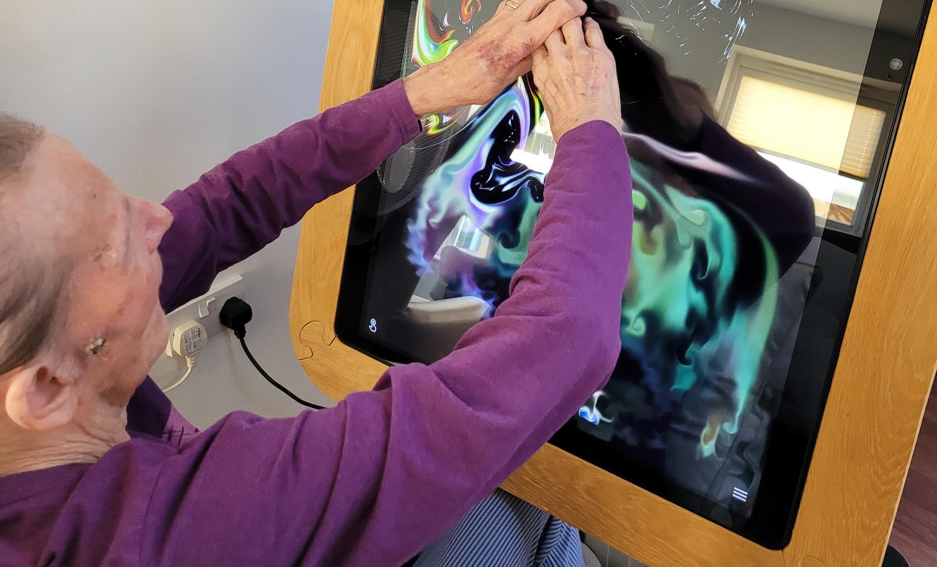
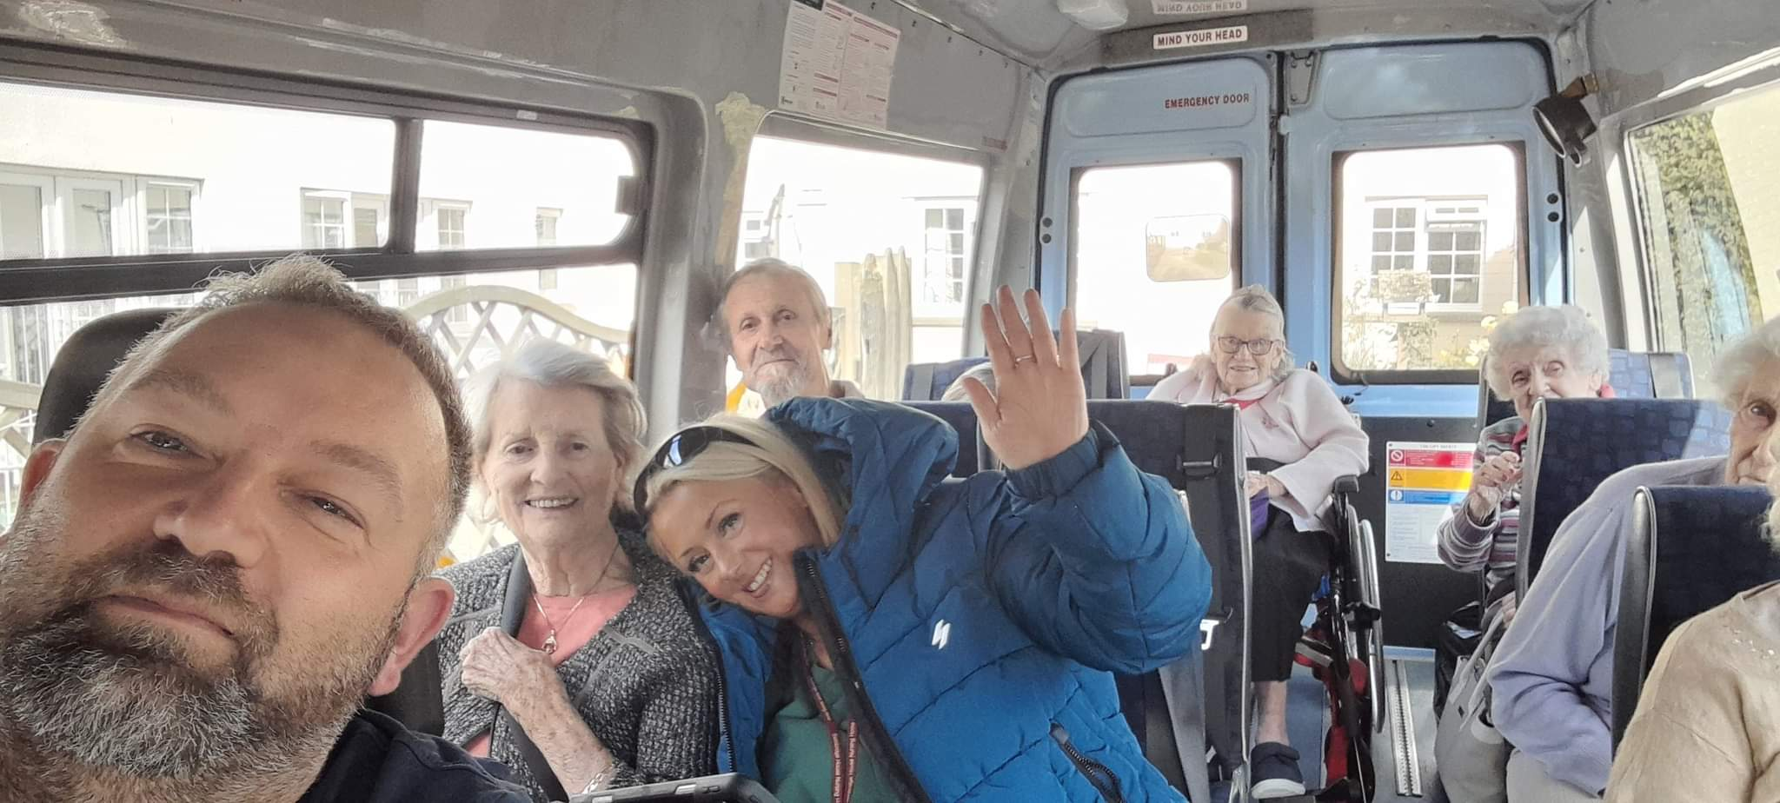
Enhanced health in care homes: Reconditioning Initiative North Devon
Dr Fiona Duncan, October 2022
GP and specialty Doctor in Healthcare for older people, nddh
Ehch and frailty lead, northern primary care collaborative board
Clinical lead for older person’s integrated care (OPIC), barnstaple alliance and torridge health PCN
Gp representative on national falls prevention co-ordination group

Slide 2
Background to project: deconditioning
Deconditioning: syndrome of physical, psychological and functional decline that occurs as a result of prolonged inactivity and associated loss of muscle strength
Deconditioning → falls
PHE report: "Covid-19: wider impacts on people aged 65 and over" : Deconditioning in the elderly, especially those with dementia and in social care settings is a big problem
Modelling predicts significant cost to the NHS as a consequence

Slide 3
Local relevance
Deconditioning and falls evident in our local CH population
Varied approaches within care homes when it comes to activity
Gap analysis: No consistent support in addressing deconditioning for our care home population
Local NHS teams overstretched
Care home staff overstretched
Increasingly frail CH population

Slide 4
Objectives
To increase activity levels in care home residents in North Devon
Address deconditioning in our local care home population and aim to reduce the risk of falls and subsequent hospital admissions.
Improve physical health and mental wellbeing.
Collaborative approach with Care Homes and teams involved in looking after care home residents

Slide 5
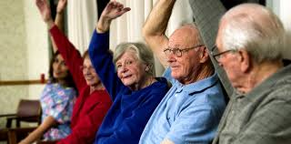
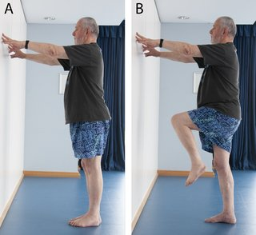
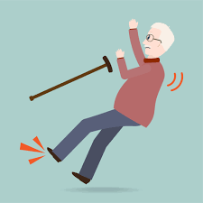
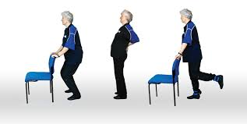
To prevent…

Slide 6
Summary of the initiative
Activity Facilitator
Fund for personalised support to CHs to increase activity
Education and training: for care home staff and PCN care home teams
Project co-ordinator

Slide 7
The EHCH Reconditioning team
Project Leads: Dr Fiona Duncan, Caroline Sanford
Activity Facilitator: Andrew Jeffery
Project Co-Ordinator: Liv Sanford
Steering Group

Slide 8
Activity Facilitator
Holistic review of activity in each care home
Guidance on basic personalised exercises for residents and support family and staff members to assist with these
Signpost to activities available online and within local community
Link in with local organisations/volunteers to provide activity that best suits the needs of the residents and care homes
Work with CH staff and other HCPs involved in care of residents→ promote awareness of how increased activity can benefit physical and mental health

Slide 9
Fund for personalised support to increase activity
Personalised funding for CHs to in increase activity levels in their residents, that will meet the specific needs of the resident and the CH itself
Can be used to purchase equipment and access programmes/opportunities that meet the specific needs of the CH and residents.
Specific criteria to be met before funding granted
Funding allocated per CH bed

Slide 10
Education and training
Activity Facilitator educates staff, patients and families on the importance of staying active.
Free online training to care home staff on activity in older adults and encouragement to engage with the "Live Longer Better" approach.
Educate staff in PCN care homes teams to enable them to better address activity and deconditioning in older people moving forward.

Slide 11
Project co-Ordinator
Manage bids process of CHs applying for funding
Collate data following bid approval
Measure outcomes
Role in signposting

Slide 12
Methods for measuring impact
Questionnaire, surveys, scores: at baseline and at 12 months

Slide 13
Outcome measures: CH Residents
Surveys looking at level of independence with ADL, walking distance in CH, time spent on feet, participation in activities
Barthel Index score
Patient wellbeing: to be assessed using WHO (Five) Well being Index (1998)

Slide 14
Outcome measures: CH Staff/organisation
Staff awareness of deconditioning and importance of promoting independence and activity in residents: questionnaire score
Promotion of activity: posters, leaflets for residents and visitors: questionnaire score
Personalised activity plan for all new patients: yes or no

Slide 15
Outcome measures : PCN Care Home Teams
Staff awareness of deconditioning and importance of promoting independence and activity in residents: questionnaire score
Patient activity assessment included in Personalised Care and Support Plan for all new residents: yes or no

Slide 16
Integration and sustainability
Work alongside existing support from NHS OT, Physio, Falls teams and PCN teams implementing EHCH
Compliment existing S&B work in CHs
Working alongside therapy teams
Education element→ makes deconditioning a higher priority for CH staff, PCN teams, families
Working with HAND and other stakeholders to look at future funding possibilities

Slide 17
Where we are now
29 Care Homes involved in the project
14 Care Homes have received their personalised funding
Linking in with the Steady on Your Feet and HAND locally
Linking in with NFPCG, Live Longer Better nationally
National recognition: project presented at Best Practice Conference, NHS England 12/10/22

Slide 18
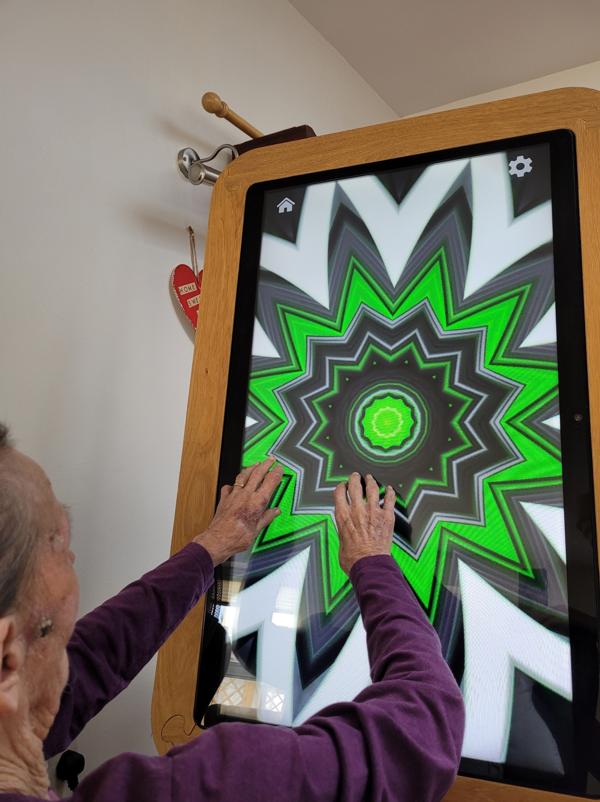

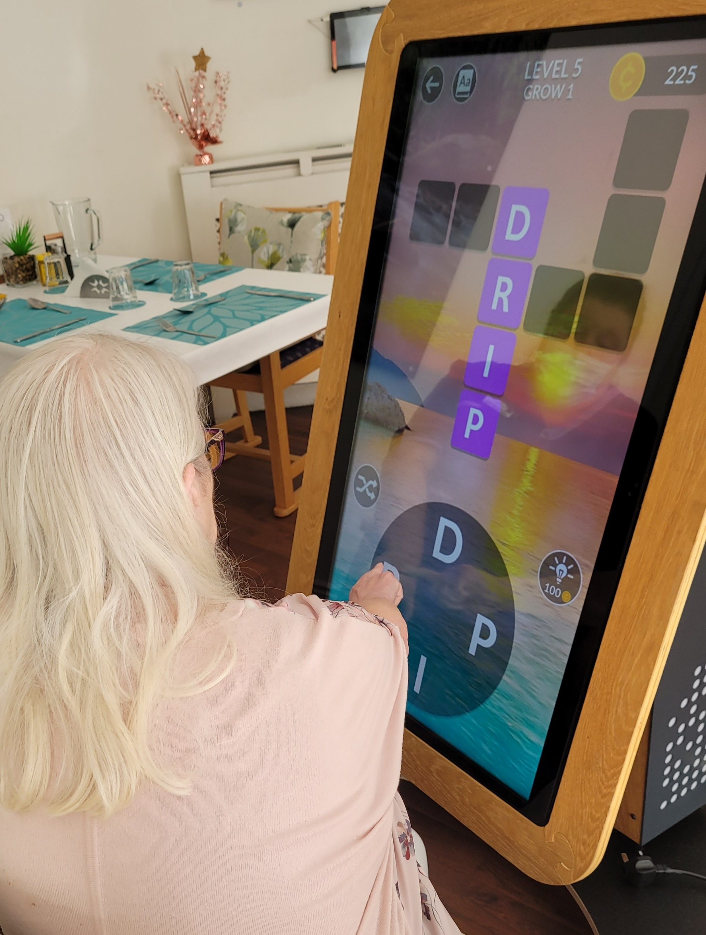
Interactive Tablet in use- benefits in terms of memory, cognition, use of upper limbs, and general wellbeing ☺

Slide 19
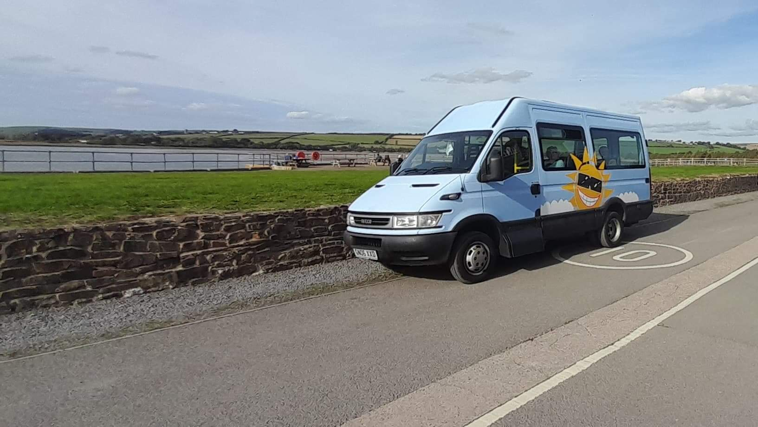
Transport enabling residents to visit the beach for a walk and to enjoy a Hockings ice-cream ☺

Slide 20
Coming up…
Engaging with those Care Homes who have not yet signed up to the project
National Reconditioning Games- initial meeting next month
Planning Meeting for 2022/2023 funding for all stakeholders involved in EHCH
Working with Therapy Lead to organise PCN educational sessions

Slide 21
Summary
Collaborative approach: with care homes, NHS therapy teams, PCN teams
Signposting to other services and offers in the area
Work closely with networks of homes to bring improvement on a larger scale
Link to national falls prevention work (NFPCG) and free online training modules for staff
Focus on education and health promotion → sustainability

Slide 22
Questions?
Dr Fiona Duncan, Project Lead fiona.duncan14@nhs.net
Liv Sanford, Project Co-Ordinator liv.Sanford@nhs.net
Andrew Jeffrey, Activity Facilitator a.jeffery3@nhs.net

