Slide 1


Supporting Unpaid Carers
Wellbeing Teams Network Meeting
July 2022

Slide 2
About unpaid carers
Family members, friends or neighbours of someone who cannot manage without them.
This can be due to a physical or mental health issue, learning disability or substance misuse.
Approximately one in eight of us are carers.
Most of us will be a carer at some time in our lives.
Notes:
50% increase in carers since onset of COVID (approx. 130,000 now in Devon)
6,000 become carers every day in the UK
7,000,000 juggling paid work and unpaid care role
Pre-COVID saved UK economy £132 billion per year; since COVID, risen to a saving of £193 billion
Sooner we get to carers in their caring journey, the longer they will be able to care, remain independent and build resilience

Slide 3
The impact of caring
Carers often do not see themselves as carers.
There can be a profound impact on carers in terms of
Neglecting themselves
Isolation
Exhaustion
Stress
Impact on work / education
Etc.
The impact on the person who is cared for – giving them the best life they can have. “The one consistent in the person’s life”
Notes:
Difficulty in carers identifying as such, or being identified:-
duty as a spouse, relative, friend or neighbour
living in rural locations
caring for someone who doesn’t recognise they need a carer
denial
guilt
previous experience
working
cared for person won’t allow the carer to have support (control)
can’t believe support is free
additional issues and challenges due to culture, sexuality, race, disability, faith, ethnicity, gender
embarrassment about some conditions, e.g. addiction
2. Carer burnout
3. Carer knows the cared for person best, which is helpful to other professionals and services – advocacy, finance, personality, habits, hobbies, humour etc

Slide 4
Support for Carers
Devon Carers / Torbay Carers offer:
Carers Assessments / Health and Wellbeing Checks
Direct payments for a break / emotional support
Someone to talk to (phone or face-to-face)
Specialist carer support - mental health, older people’s mental health, learning disabilities, Young Adult Carers (16-25) Young Carers (under 18)
Hospital services
Free / discounted hospital parking (when attending in support of the person you care for)
Carer Passport / alert card
Notes:
90% of our services are available without the need of a Carers Assessment
Carer Passport and Welcome Pack
Carers Break Fund
Hospital Services – NDDH, RD&E, Torbay & Derriford
Website
Helpline
Alert Card
Escalation Plan

Slide 5
Support for Carers (continued)
Back-up plan (in case of emergency)
Peer support
Sitting service
Carers training / education
Quarterly newsletter
Support / signposting to help with finances
Notes:
Time For You Sitting Service
Carer Friendly Devon?

Slide 6
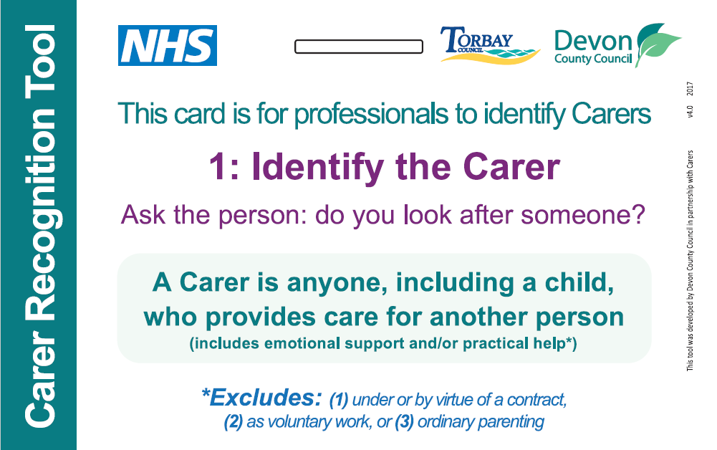
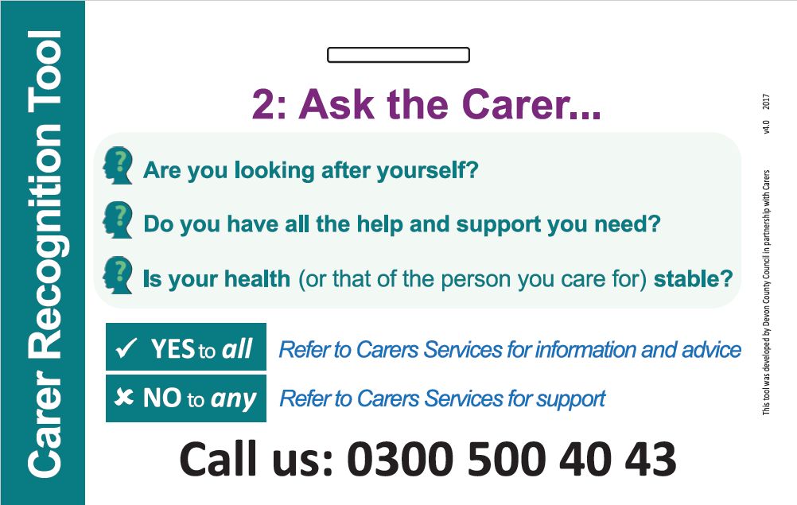
Carer Recognition Tools
Reminder to identify carers
Questions to prompt conversations
One number to signpost carers to for information, advice and support

Slide 7
How can you help carers?
Identify (and record) carers who you speak to
Explain there is support available (and what it is)
Challenge “I’m just their husband / wife / son” etc. – Looking after themselves makes the whole situation more sustainable.
Explain that being a carer does not make them any less of a wife / husband etc., and that they don’t have to do this alone / at all.
Give our number out or call yourself to refer in. We will only do what the carer asks us to do, and we are not linked with benefits etc. In fact there could be a financial benefit to speaking to us.
Notes:
Referral routes

Slide 8
Can we link better with you?
We are always looking for new ways to identify and support carers.
We overlap with many providers with similar objectives.
How can we work with you to our mutual benefit?
Carer Awareness training
Notes:
Regularly meet with our locality teams to maintain collaborative working and to avoid duplication
Digital training and bespoke face-to-face training

Slide 9

Contact us
www.devoncarers.org.uk
Ask a question on Pubble Live Chat
t: 03456 434 435
e: info@devoncarers.org.uk
www.tsdft.uk/carers
T: (01803) 66 66 20
e: signposts@nhs.net
Torbay Carers

