Slide 1
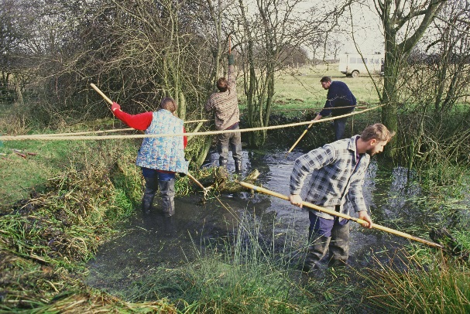
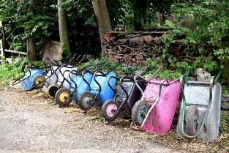
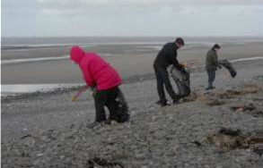
One Northern Devon Daphne Marston, Regional Health & Environment Lead Advisor, South West

Slide 2
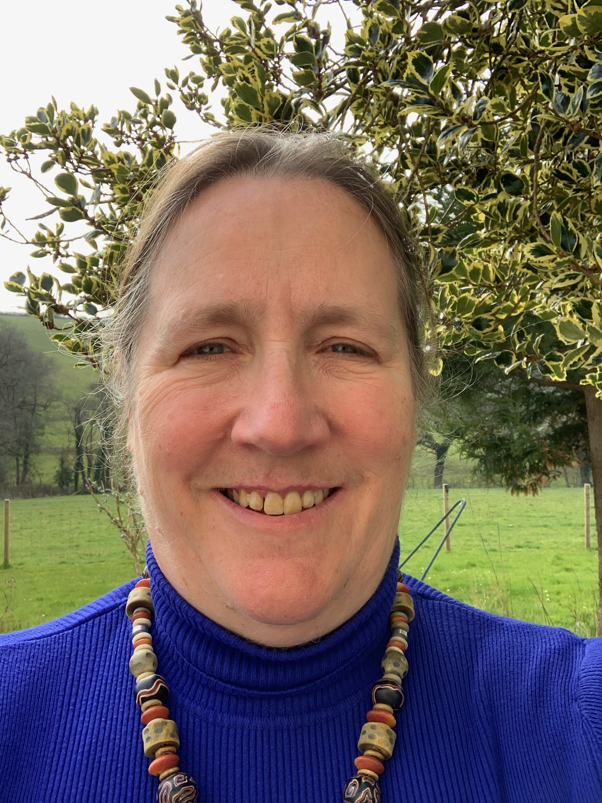
Daphne Marston
Natural England South West regional health lead advisor
(since January 2022)

Slide 3
Regional Health Lead Advisor – SW
Part of a national team of 7 regional health and environment leads across England. Team expanding with 7 senior advisors
What are my current goals?
Build a picture of provision: green/blue providers in South West
Build partnerships for delivery of green and blue social prescribing
Understand what is happening now in the region, where the gaps are and how to link up similar initiatives.
Work closely with The National Academy for Social Prescribing (NASP): create partnerships across the arts, health, sport, leisure and Money and Debt advice services.
Work with colleagues in Natural England to further connect people with nature and embed health in all our work.
Trying to build GSP in good quality greenspace (thriving nature for thriving people)
To give people the opportunity to make a connection to nature through experiences that they have.

Slide 4
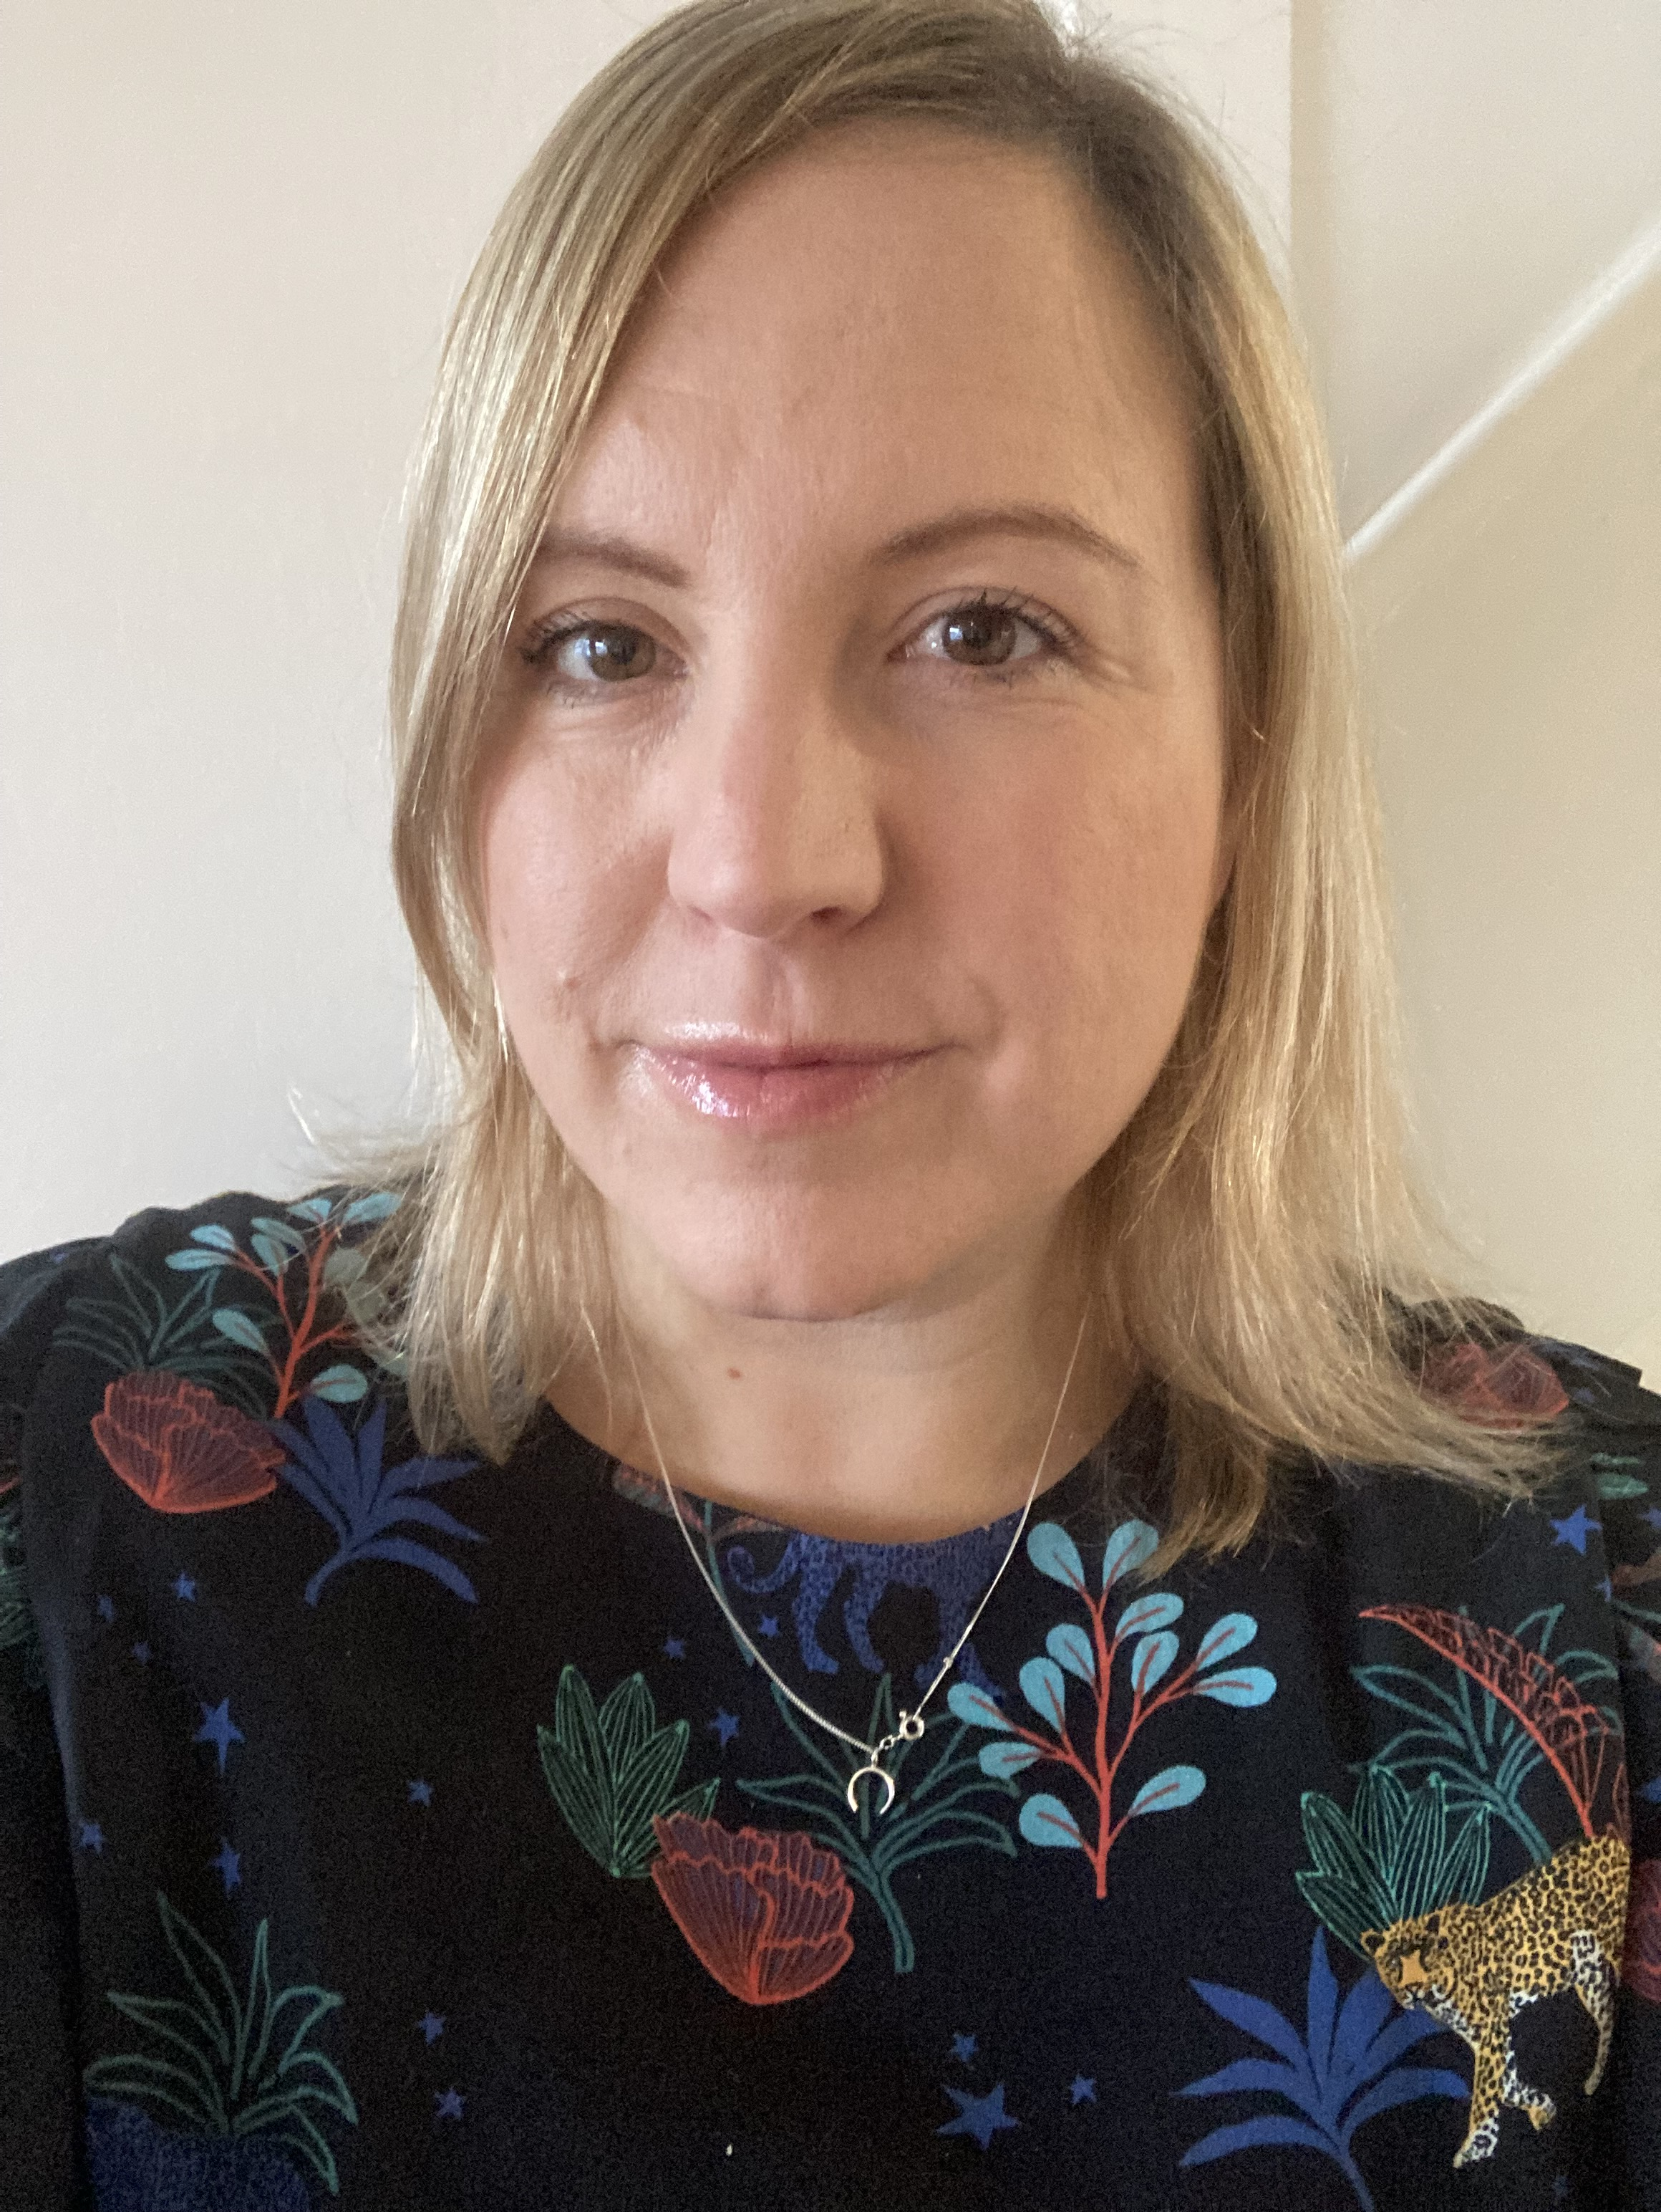
Mel Smith
Senior Advisor- Inclusion and Connecting People With Nature

Slide 5
Role- Senior Advisor for Inclusion Connecting People with Nature
To support area teams to consider inclusion in all our work
To lead in understanding and addressing barriers to accessing nature in Devon, Cornwall and the Isles of Scilly
To increase people’s* contact with nature and connection to nature.
To develop partnerships and to support NE to connect with diverse communities.
*especially people who have traditionally had fewer opportunities or who have been less welcomed

Slide 6
Natural England Purpose, Vision & Mission
Purpose: Help conserve, enhance and manage natural environment for the benefit of present and future generations, thereby contributing to sustainable development
Vision: Thriving nature for people and planet
Mission: Building partnership’s for nature’s recovery
Notes:
Natural England are the government’s adviser for the natural environment. An executive non departmental public body sponsored by DEFRA.

Slide 7
Natural England priorities
Well managed Nature Recovery Network across land, water and sea
People connected to nature
Nature based solutions contributing to tackling climate change challenge and wider environmental hazards and threats
Improvements in the natural capital that drives sustainable economic growth, healthy food systems and prospering communities.
Evidence and expertise
Value led organisation
Connecting all People with nature is at the core of Natural England
Notes:
6 key priorities and can see that connecting people with nature is a key one. It is becoming embedded in many roles and there are now roles soecifically designated to support this

Slide 8
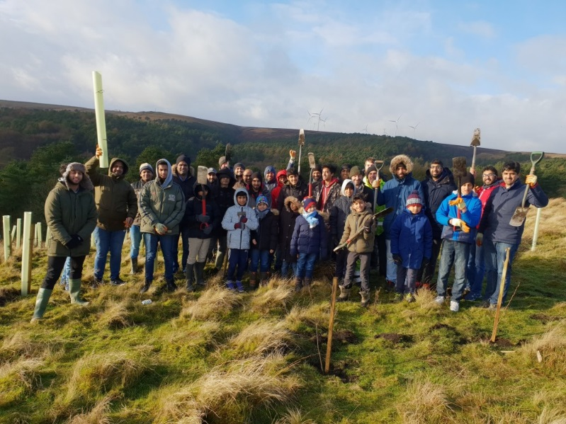
Aims of the Connecting People with Nature Programme
The programme is ambitious in its aim to deliver systemic change through the following 5 year aims:
More people connected with and acting for the natural environment
More people spending time in nature
More people benefitting from the natural environment
Better quality accessible nature-rich places close to where people live
Better access to high quality nature further afield
More resilient environment that protects people from environmental harms e.g flooding, air pollution
Notes:
My role sits within the wider connecting people with nature programme and is one of 12 across England, which is working to the following aims over the next 5 years.
People have to be an integral fundamental part of the solution.
And Inclusion is a key principle underpinning the programme, making how we do our work more inclusive and bringing more people along with us is a foundation of the programme.
Inclusion basically means creating the conditions for all people, no matter their background or circumstance, to feel welcome and that they belong.
Being inclusive is about the work we deliver and the organisation that we are, how we approach people, how we represent ourselves as an organisation, how other people perceive and view us.
How we communicate and the language and images that we use
It is about better representing the communities we serve
Ultimately we are looking at more people being able to enjoy the benefits of the natural environment and to develop a sense of ownership of it.

Slide 9
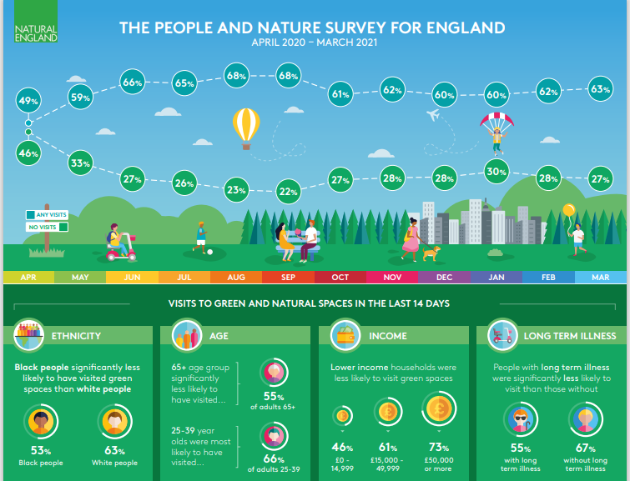

Slide 10


Where does my role fit in?
The Natural England agenda
Dovetails
with the NHS agenda

Slide 11


Links between Nature, Health and Wellbeing
Public health messaging
Nature in everyday life
Primary prevention - General population
Health needs
Nature-based health promotion
Health promotion – at risk groups
Public health initiatives
Green Care
(Nature-based therapy & care interventions)
Specific population groups
Health
& social care interventions
Source: Adapted from Bragg and Leck, 2017; and Thrive, 2017
Notes:
General population – refers to everyone …. Local greenspaces near homes
Particular population – refers to particular groups within the general population such as communities that rank highly in Index of Multiple Deprivation in which individuals are ‘at risk’ rather than ‘at need’ of treatment interventions, then there is specific green care ie Green social prescribing
Special populations – is a term used by Diane Relf to describe those with an identified healthcare need such as disability groups and those with defined ill health

Slide 12
Proven Wellbeing Benefits
85% of adults were happier after time spent in nature during lockdown (Natural England)
After being part of a 12-week nature and wellbeing programme 83% pf participants improved their mental wellbeing (Wildlife Trusts)

Slide 13
Environmental benefits
People with a greater connection to nature are more likely to behave positively towards the environment, wildlife and habitats.
increasing evidence of a positive relationship between a person’s connection to nature and their health and wellbeing. Experiencing nature is thought to provide health and wellbeing benefits. This is a potential ecosystem service that could start a positive feedback loop between health, wellbeing and connection to nature that leads to benefits for biodiversity conservation.

Slide 14
Nature Connectedness
Nature connectedness captures that relationship between people and the rest of nature. Nature connectedness is a measurable psychological construct that moves beyond contact with nature to an individual’s sense of their relationship with the natural world.
People who feel closer to nature are happier and more satisfied with life and are more likely to take actions that help wildlife and the environment.

Slide 15

Nature Connection Handbook
Nature Connectedness Research Group was formed at the University of Derby in 2013 and how now released the Nature Connection Handbook which was supported and funded by Natural England.

Slide 16

How do people connect with nature?
‘Green’ activity (e.g. park run, dementia walks),
Gardens and local parks even a plant on a window sill
Active travel (walking, cycling),
Nature and art projects
Interactions with creatures (e.g. dog walking, bird watching)
gardening, allotment and food growing, therapeutic horticulture
farming (e.g community farming inc city farms, care farming)
Forestry/woodlands (e.g walks, forest bathing, woodland crafts)
Schools and Forest school activities
environmental conservation volunteering including green gym.
Blue environment: wild swimming, beach clean, rock pooling.
Specifically designed interventions for people with a defined health needs delivered by trained/qualified practitioners.
Watching nature on television / internet. Webcams.
Notes:
These are just some of the ways we connect with nature.

Slide 17
Barriers of access to nature/nature recovery
Nature seen as ‘dangerous’ and a ‘wilderness’
Transport
Footwear and clothing
Income
A lack of lived experience of nature
Weather
Facilities eg toilets, covered area
Health challenges
Lack of parking
Accessibility eg some NNRs
Lack of good quality green space near to home

Slide 18

Any Questions?
For further enquiries or comments, please do not hesitate to contact us on:
Melanie.smith@naturalengland.org.uk
daphne.marston@naturalengland.org.uk

