Slide 1
Homeless and Socially Excluded Groups Health and Wellbeing Needs Assessment and Options Appraisal
Charlotte Pavitt
Consultant in Public Health
Charlotte.Pavitt@devon.gov.uk

Slide 2
What is Inclusion Health
Social gradient in health
Wider / social determinants of health and the interaction of such determinants have a huge impact on individuals health and wellbeing
Substantial inequality threatens social cohesion
Socially excluded populations:
the homeless, people with substance use disorders or severe mental ill health, sex workers, migrant workers and asylum seekers, gypsy, Roma, travellers and prisoners for example.
mortality rate that is nearly eight times higher than the average for men, and nearly 12 times higher for women.
The challenge is to bring socially excluded populations in from the cold—literally and metaphorically—and to provide them with the opportunity to be part of a diverse and flourishing society.
Notes:
The social gradient in health describes a graded association between an individual's position on the social hierarchy and health: the lower the socioeconomic position of an individual, the worse their health.¹
The fact that the social gradient extends from the highest echelons of society to the lowest suggests that everyone is affected to a greater or lesser extent by the social determinants of health.
One component of social cohesion is making common cause between people at various points on the social ladder. However, people at the extremes can appear to be on a different scale to the rest of society.
In societies with substantial inequality, the considerable gap between the top 0·1% of income earners and the rest of society threatens social cohesion.
Different, too, are socially excluded populations: the homeless, people with substance use disorders, sex workers, and prisoners. These individuals can seem to be off the scale of the social hierarchy completely, which represents a further challenge to social cohesion.
To put it less colourfully, the causes of excess morbidity and mortality in socially excluded populations (ie, the social determinants of health) are not so much different from the causes of health inequalities more generally but differ in their degree. Multiple intersecting causes and multiple forms of morbidity characterise social exclusion. The result is people with little hope or prospects and considerably shortened lives. The challenge is to bring socially excluded populations in from the cold—literally and metaphorically—and to provide them with the opportunity to be part of a diverse and flourishing society. The concerned practitioner might despair at achieving such social inclusion.

Slide 3
Understanding Barriers to Health Care
Institutional: opening times, appointment procedures, location of Surgery
Mainstream GP’s may require proof of address for registration
Financial: disincentive for GP’s to register Rough Sleepers, especially if they are transient
Lack of integration between Primary Healthcare and Social Services, Criminal Justice and the Voluntary Sector

Slide 4
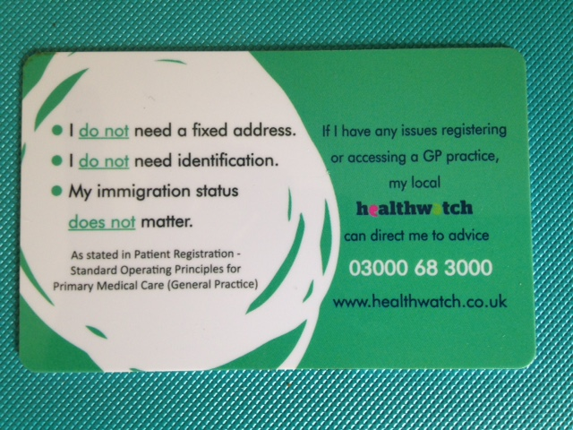

Understanding Barriers to Health Care
Some homeless people have poor engagement skills and chaotic lifestyles which makes it difficult to book and keep appointments
Notes:
Need to update this to make it fit with the following info

Slide 5
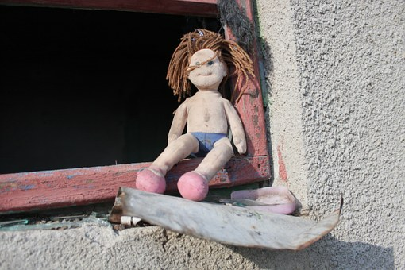
Understanding Barriers to Healthcare
Trauma
Loss
Treated unfairly or differently
Attitudes of Health and Allied Professionals
Personal Agency

Slide 6
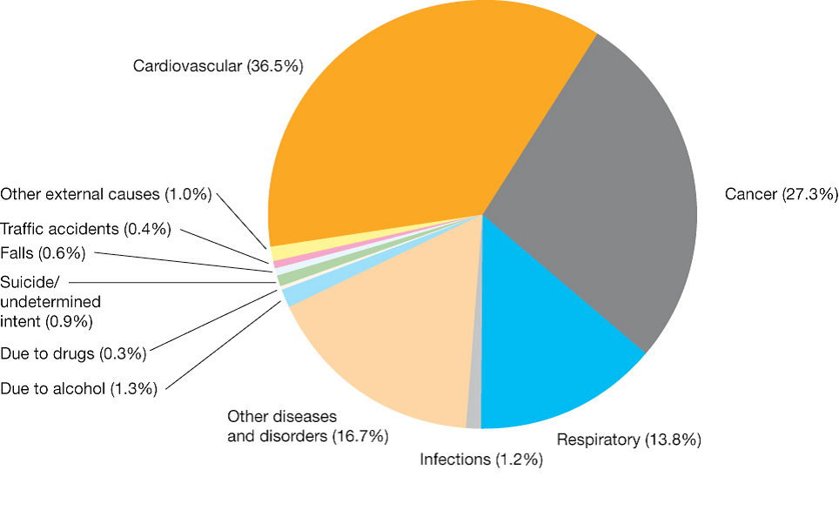
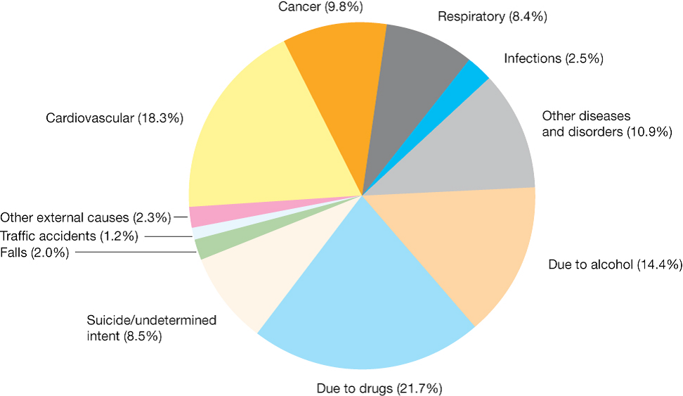

Mortality
General Population
Homeless Population
Notes:
Crisis report (2011) Silent Killer

Slide 7
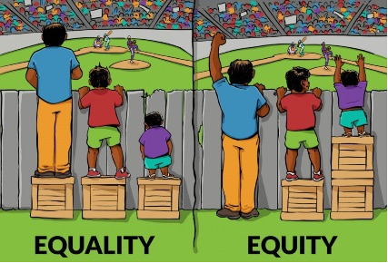
Equity is key

Slide 8
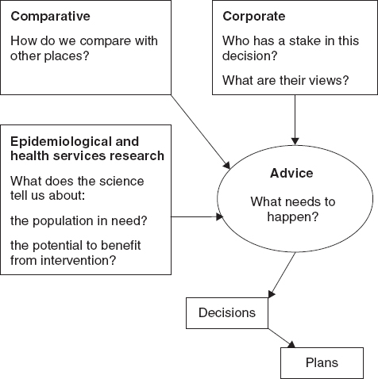
Health Needs Assessment
Your insights and views on:
Data that informs needs and service provision
Qualitative data and insight of those with lived experience (case studies)
Current service provision and support available – and the gaps!
Good practice elsewhere
Your views and ideas for improvement
Refugee, Asylum Seekers and People on resettlement schemes stakeholder form
Homelessness in Northern Devon Stakeholder form

Slide 9
Timeline and next steps
Further stakeholder meeting 31st August
Presentation of first draft of updated needs assessment to the Northern Locality Partnership Forum (part of North Devon Local Care Partnership) 6th September
Circulation of the 1st draft to stakeholders for further comment, ratification and to coproduce the recommendations – September 2022
Finalise the report – October/November 2022
Inform commissioning decisions for 2023 onwards

