Slide 1


Postural stability instructor (PSI) Training
PSIs undertake training to deliver FaME

Slide 2
PSI (FaME Training) considerations for commissioners:
Do service providers have an implementation plan?
Who will coordinate implementation of FaME?
  PSI training eligibility checks pre-training
  Agree/liaise with referrers
  Organise venue/equipment/transport/social aspects
  Set out a clear participant/older person journey; recruitment/reach, assessment, participation, data collection, evaluation
  Support PSIs e.g., NFIT Community of Practice (fidelity/quality improvement/CPD)

Slide 3
PSI (FaME Training): eligibility for exercise professionals
!
- L2 Fitness Qualification &
- L3 Exercise Referral &
- Exp of working with older people
Have sufficient/required entry level knowledge & experience?
Understand expectations (on completion of the training?)
Yoga, Pilates, Dance Teachers etc. may not have these
!
- Deliver FaME with fidelity (not FaME’ish!)
- Pre-session assessment
- Data collection requirement's
Implementing FaME
is more than
delivering a session

Slide 4
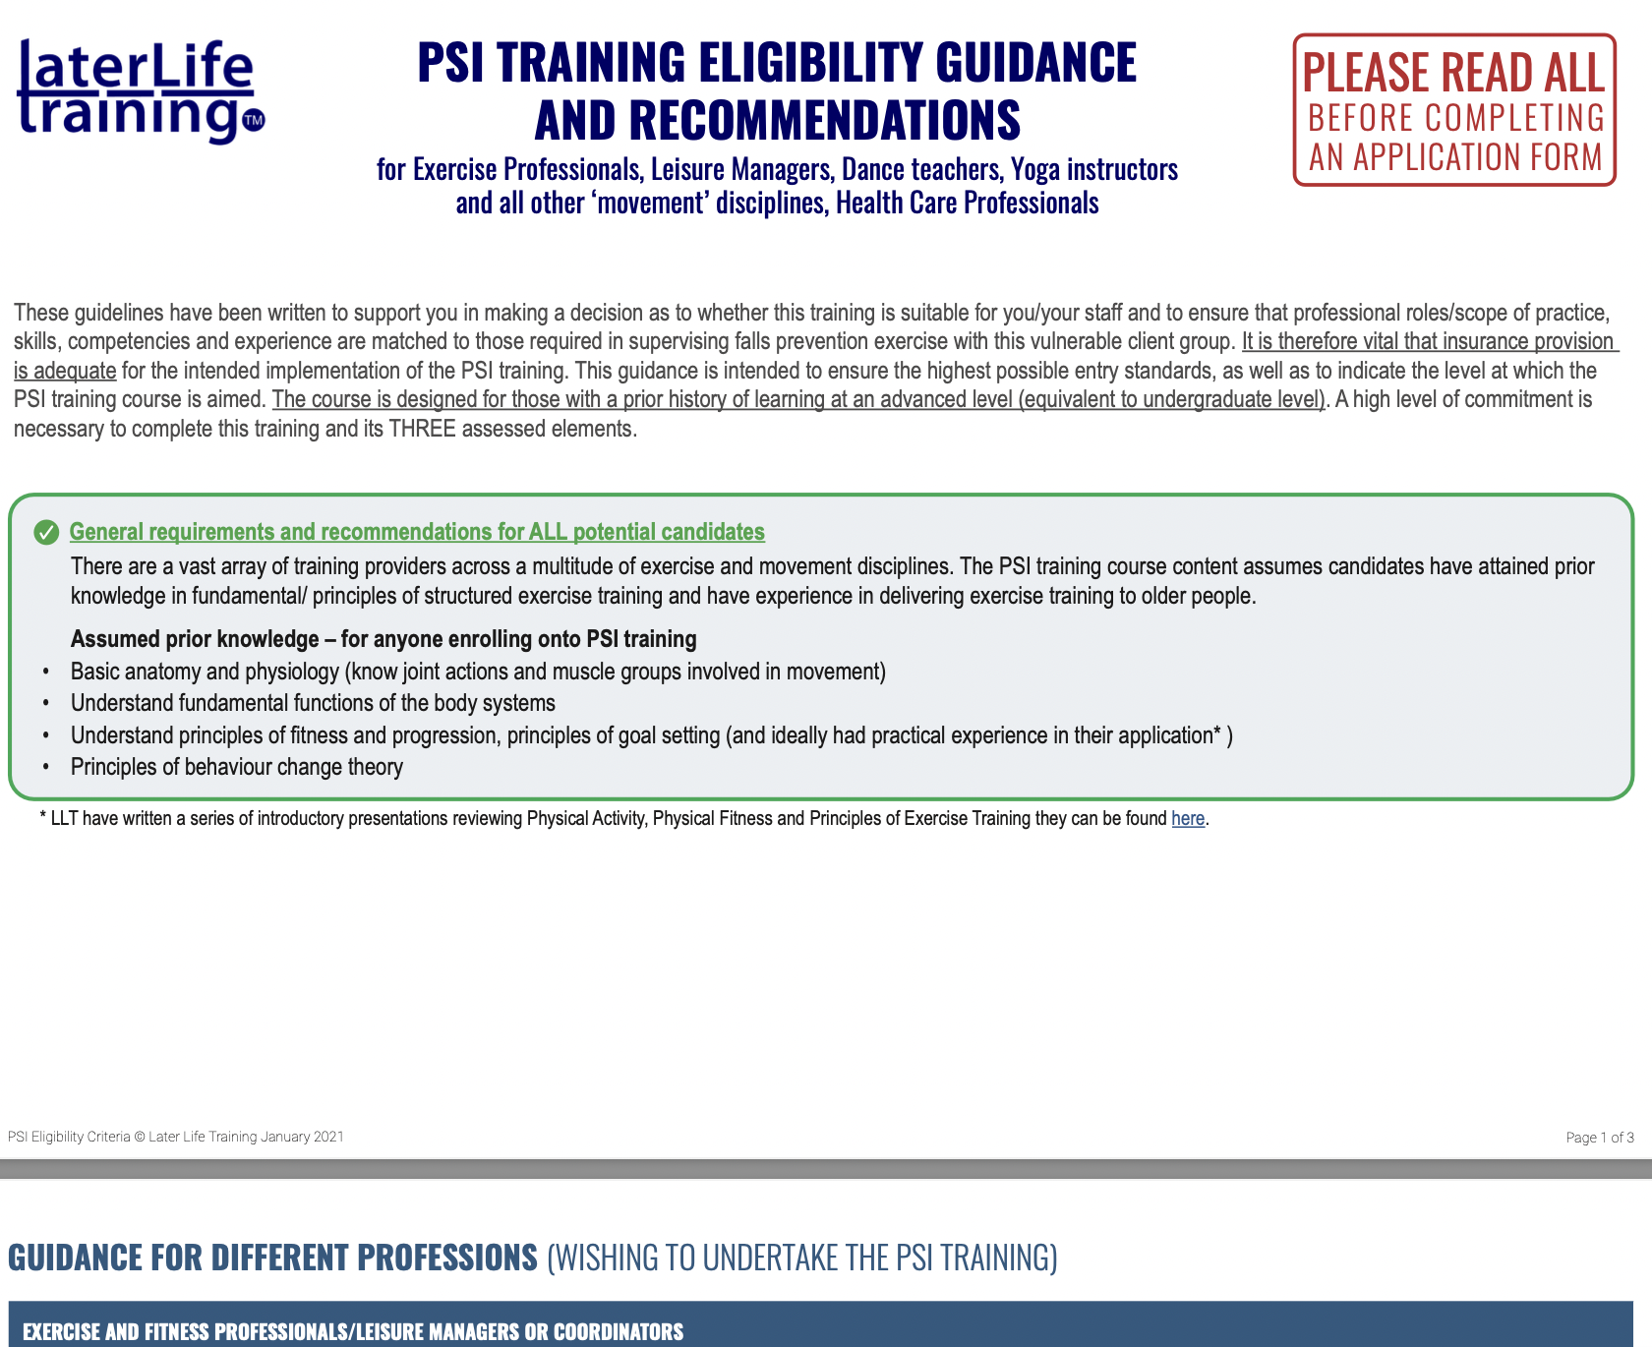
Scope of practice:
It is the candidates’ responsibility to understand their scope of practice and associated insurance provision
Candidates are required to read LLTs full eligibility guidance BEFORE THEY ATTEND TRAINING;
https://www.laterlifetraining.co.uk/courses/postural-stability-instructor/psi-eligibility/

Slide 5
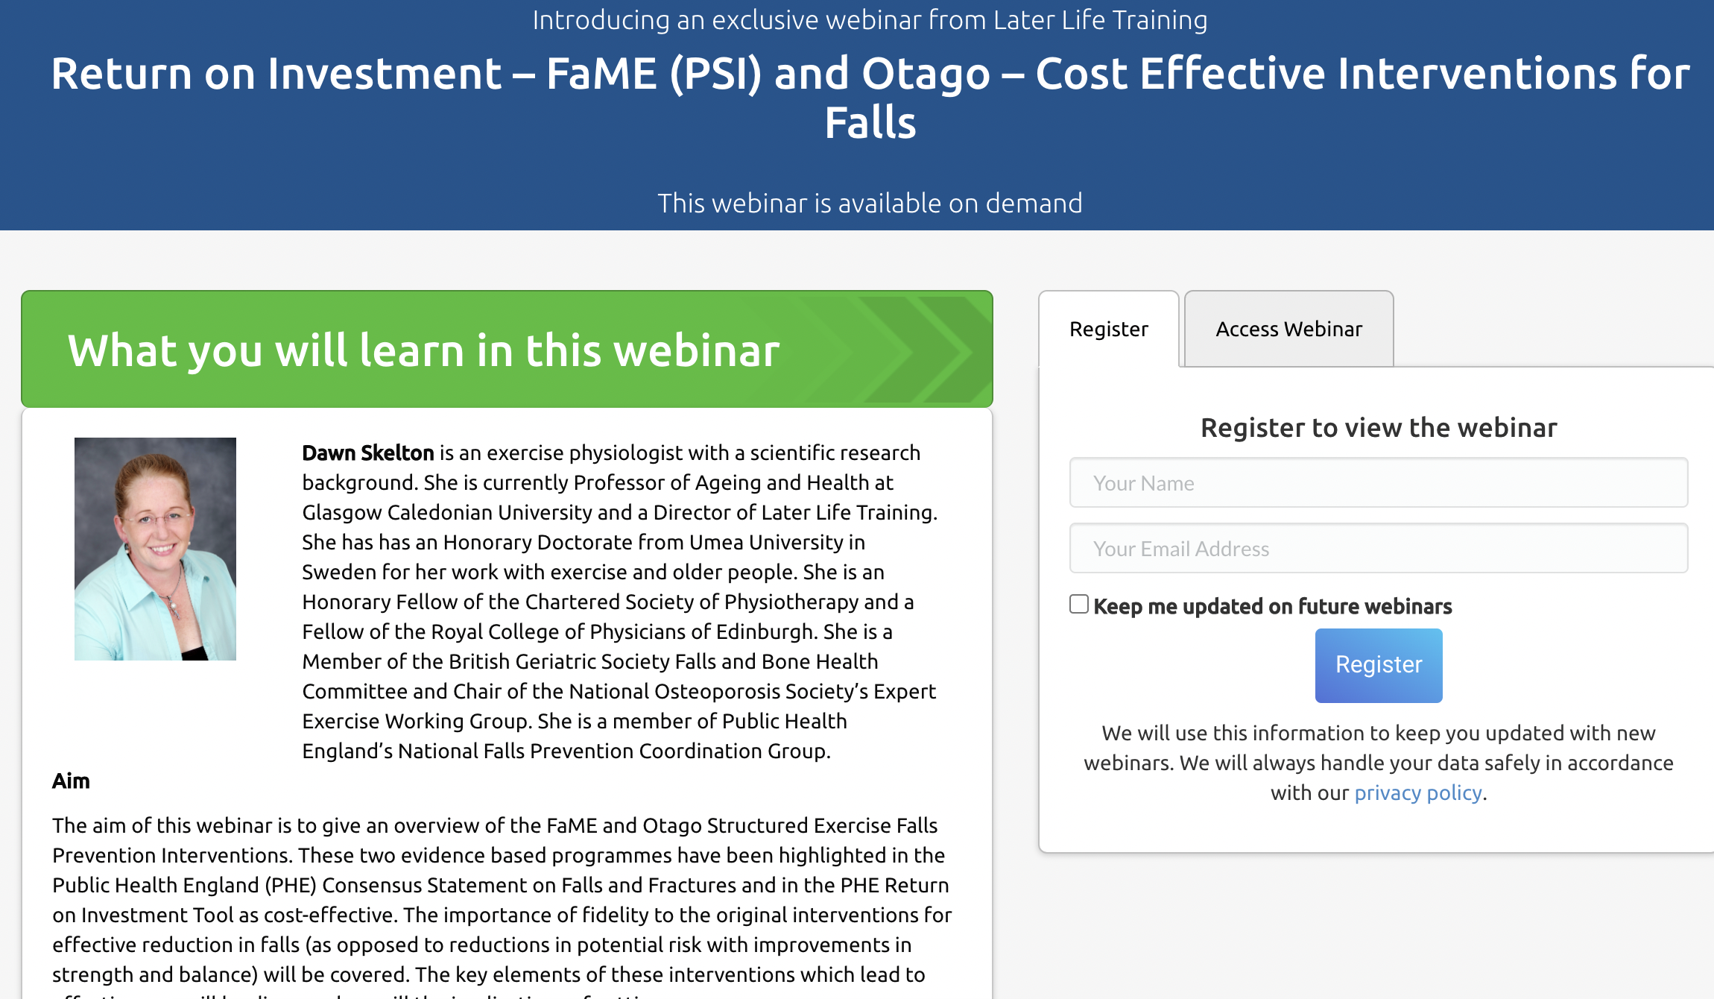
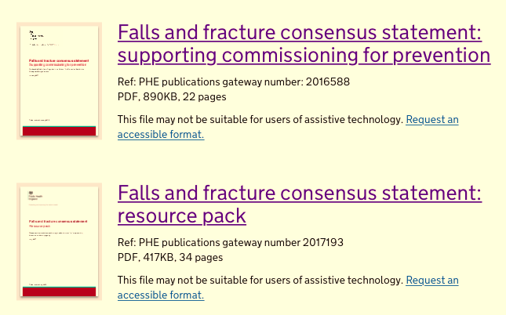
PSI eligibility and potential impact on ROI?
FREE
webinar
https://www.laterlifetraining.co.uk/webinars/return-on-investment-fame-psi-and-otago-cost-effective-interventions-for-falls/
https://www.gov.uk/government/publications/falls-and-fractures-consensus-statement

