Slide 1

Trauma Informed Care – The New Normal
One Northern Devon Approach
Presented by Encompass Southwest and supported by Making Every Adult Matter (MEAM)

Slide 2
The Power of Everyday Heroes
https://www.youtube.com/watch?v=q3xoZXSW5yc
We should not underestimate the capacity of positive interactions, even routine interactions, to be therapeutic and validating. Positive experiences of relationships are central to trauma recovery, whilst negative experiences in relationships can exacerbate emotional and psychological impacts.

Slide 3
An introduction into TIC
Trauma-informed care shifts the focus from “What’s wrong with you?” to “What happened to you?” from “You to us”
Trauma-informed care seeks to:
Realise the widespread impact of trauma and understand paths for recovery;
Recognise the signs and symptoms of trauma in individuals, families, and staff;
Requires more than 1 person or 1 agency it is a whole team around the person (TAP)
Integrate knowledge about trauma into policies, procedures, and practices; and
Actively avoid re-traumatisation. – example case study later slides

Slide 4
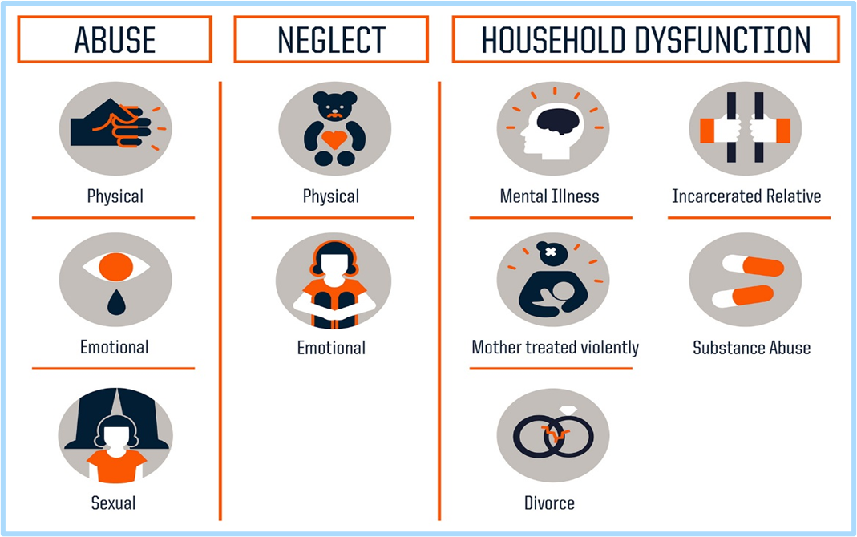
Why Now
80% of frontline policing is dealing with vulnerability CoP 2019
Most of our clients have experienced some kind of Childhood adverse Experiences (ACES)
To make a real difference to some of our most complex clients. Stopping the cycle and intergenerational complexities.
To learn from other areas and share best practice – Trauma Informed Network

Slide 5
Trauma and the Brain
https://www.youtube.com/watch?v=4-tcKYx24aA

Slide 6
The principles of Trauma Informed Care
Safety – Clients feel safe within the service, project, accommodation etc.…
Transparency and Trustworthiness – Decisions are made together with a goal of building trust.
Collaboration - working with a shared goal approach to decision making, removing the power between professional and client.
Empowerment – Strength based approach. Client and staff strengths are recognised, built on, and validated, this includes a belief in resilience and the ability to heal from trauma
Humility and responsiveness – Historical trauma is recognised and addressed. Client Led when they are ready to deal with their Trauma
Peer Support – Individuals with shared experience are integrated into the organisation, project or partnership and are viewed as an integral part of the service delivery.

Slide 7
Simple changes that can be made
Instead of asking “What's Wrong” we should be asking “what's happened”
Accept that due to their lifestyle they may not turn up to appointments or maybe late, we should not punish them for this we should recognise that often the complexity and trauma has led to this.
People who have experience childhood trauma live their lives in fear and pain often 24/7 so let's not punish these people lets give them the help they need.
Clients in their journey will visit multiple services and repeat their stories, this means repetitive revisiting of the trauma (GP, police, housing, mental health, IDVA, supported accommodation, drug and alcohol services, projects etc) – can GP’s have one point of contact for clients with Trauma
Open and honest discussions with client result in the same back, they will tell us the actual issue rather than disguise it with other issues
Provide the space and security to look at moving on from trauma rather than a ‘sticky plaster on a broken leg’
Remember people can overcome adversity – protective factors, people can survive and flourish a quote which we should remember is “One day all of this pain will be useful to you” people can grow from adversity and we should remember that

Slide 8
What we need to do now?
Acknowledging the impact Trauma has on a person's life.
Have buy in from a strategic level – A real commitment to do something different
Build connections with other Trauma informed areas (Plymouth) to develop a trauma informed region.
Develop co-production frameworks as part of the Flow/One Northern Devon partnerships
Engage with the MEAM approach
Local pathway which includes health and removes barriers to support

