Slide 1
Proposed architecture of the Northern
Local Care Partnership
Katherine Allen
October 2020

Slide 2
Structural changes to the NHS
New architecture of distributed health and social care leadership – ICS(Integrated Care Systems) – LCPs (Local Care Partnerships (Place)) – and Neighbourhoods
Ambition: As we look to the future, we want to move towards a vision for health and care that starts with people and populations and that accelerates joint working across partners to create an offer that improves population health and that addresses health inequalities.
COVID-19 has emphasised the importance of integration locally –e.g. support for care homes and shielded groups –and the imperative for providers to work collectively through strong mutual aid and shared planning arrangements.
Creation of 5 LCPs in Devon – one in North – that will eventually hold budget for H&SC in Northern Devon.
Given the strong and emerging partnerships in Northern Devon we would like to avoid starting from scratch and align with what is already in place

Slide 3
One Northern Devon Partnership
Partners Regional Statutory Bodies
One Northern Devon Partnership Board
All Health (incl PCN / GP leaders), Police, Housing, LA + District Councils, Public Health, Healthwatch, VCS, Business, Environment
1. Northern Integrated Delivery Group
Management and performance of the health and care system
Planned care
Unplanned care
2.
Economy Board
Innovation, ND+, employment and skills
3.
Environment,
Place & Community Board
Clean, safe and sustainable places, One Communities
4.
Health and wellbeing
NEIGHBOURHOOD: One Communities
Bideford, Braunton, Holsworthy, Ilfracombe, South Molton, Torrington
Operational links with town and parish councils, VCSE, PCNs and local OND partner teams, i.e constables, H&SC teams
Social Prescribing and prescriber peer network, Community Developers
Partners retain statutorily accountable to their individual regulators.
Rationalisation of multiple groups meeting within the Area.
Partnerships Board providing oversight & coordination
Establishment of One Northern Executive with unfettered, non-aligned responsibilities (Joint/seconded posts)
Delivery of ICS priorities
Democratic Leaders.
CEOs / leadership group of all partners.
Chairs of Thematic Groups 1-4
System review and assurance.
Thematic Groups 1-4
Senior officers. Leaders/Chairs of delivery projects and partnerships
One Northern Devon 10-year wellbeing strategy is already aligned to Devon H&WB strategy.

Slide 4
Aligning OND and LCP
ICM, A&E Board and Planned care boards
One Northern Devon created in 2018
OND has a 10 year wellbeing strategy agreed with all partners in 2020
OND’s strategy aligns to Devon H&WB strategy + LTP
Workstreams in place – economy, H&WB and place led by range of partners (not just NHS)
Partners are in place and engaged in adjusting to new LCP/ICS architecture

Slide 5
Northern LCP Integrated Delivery Group
ToR and roles and responsibilities being developed
Management and performance of the health and care system
Population Health Management
Membership emerging from ICM, A&E Board and Planned care boards.

Slide 6
Economy Board
Innovation, ND+, employment and skills
Rationalisation of multiple groups
Projects sponsored by partners & delivered collaboratively
OND’s present programmes
Support for local employers.
Local supply chain
Increasing employment opportunities
Local supply chain initiative
Work place Health Champions

Slide 7
Environment, Place & Community Board
Strong public/community involvement
Council initiatives (Hubs etc)
OND’s present programmes:
Climate emergency
Fuel poverty
Strong, resilient communities
Grow, Share, Cook

Slide 8
Health and wellbeing
Alignment to H&WB scrutiny, LTP prevention priorities and PH Health and Wellbeing strategy
As well as council initiatives i.e. rough sleepers
OND present programmes
Child poverty
Loneliness
Obesity and healthy weight
Crisis prevention and support

Slide 9

Our 10 Strategic Priorities
Please refer to OND’s ‘10 Year Quality of Life Strategy – 2020-2030’ for the detail

Slide 10
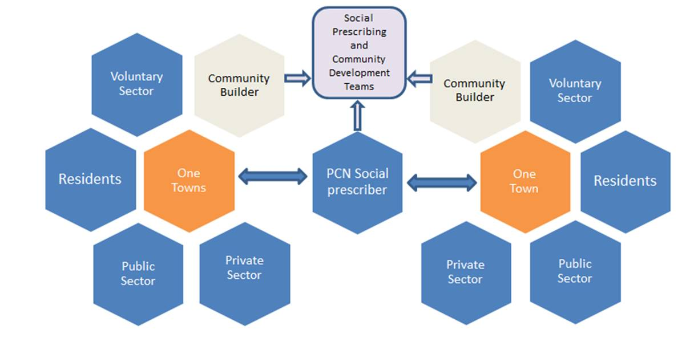
How we work at neighbourhood level

